Slide 1


Crediting in Agriculture in Slovak Republic
Ing. Mgr. Marianna Čertíková
Specialist for Agri Clients, ČSOB Bank a. s., Slovakia (member of KBC Group)
mcertikova@csob.sk

Slide 2
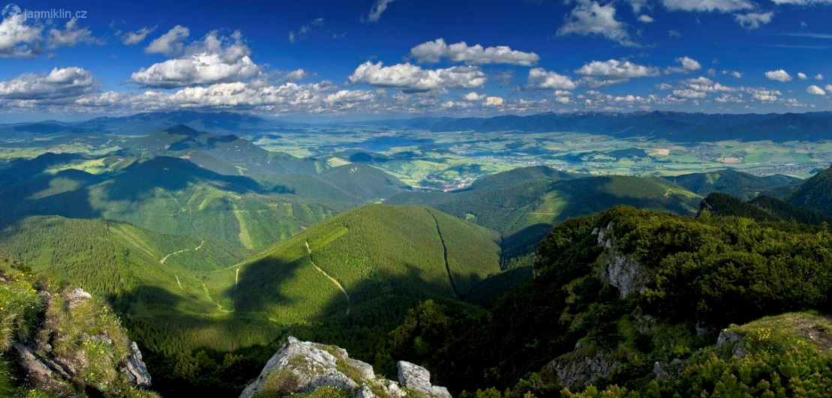
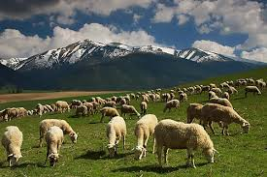
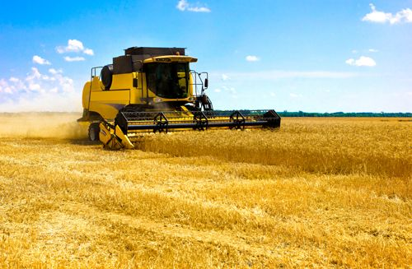
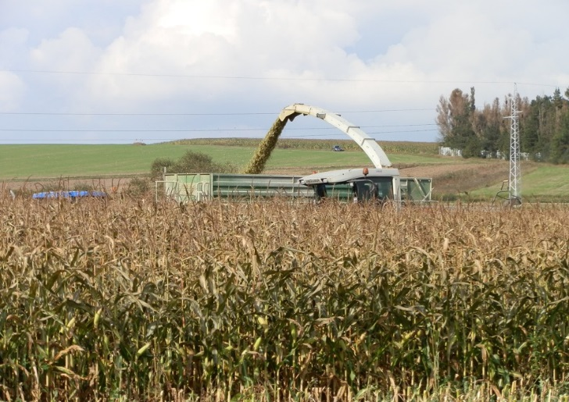
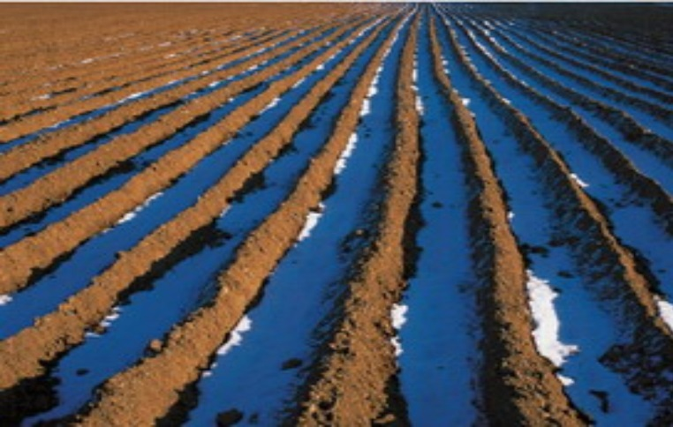
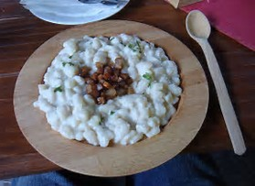
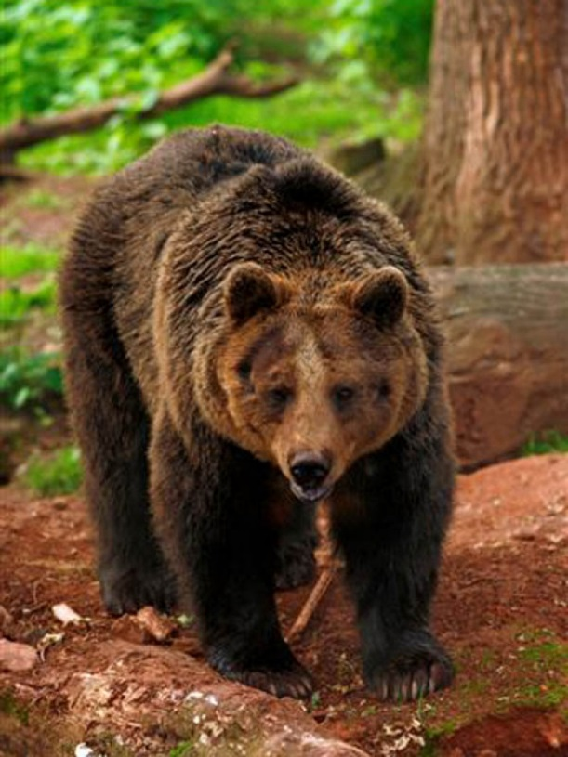

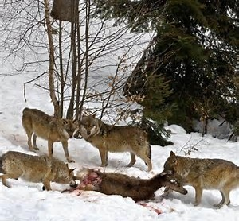
Slovakia
Number of inhabitants: 5 427 917 mil. ( of which half lives in rural areas)
Area of SR: 4 903 459 ha (49 035 km²)
of which:
Agricultural land: 1 921 563 ha
Arable land: 1 350 180 ha
Forests: 2 020 116 ha

Slide 3
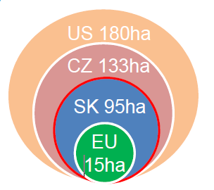
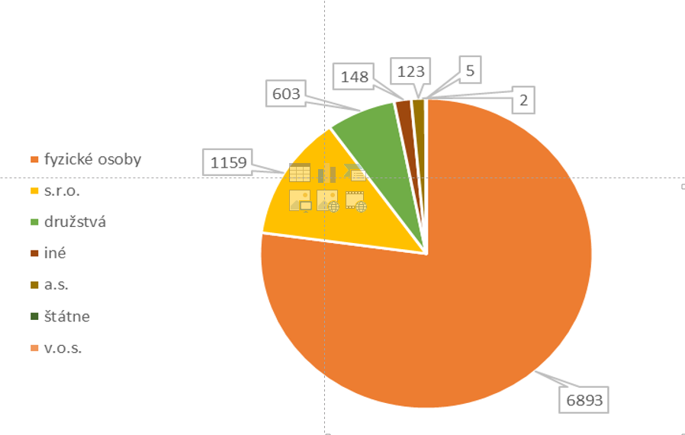
Agriculture – state of play
Share of SR agriculture on EU-28: 0,6%
Share of EU-15 agriculture on EU-28: 83,6% (France, Germany, Italy, Spain)
Share of agriculture and food sector on gross added value of SR: 4,05%
Share of agriculture and food sector on employment of SR: 1,89%
Minimum wage: 480 Eur, Average wage in agriculture: 702 Eur, (average wage in national economy: 954Eur)

Slide 4

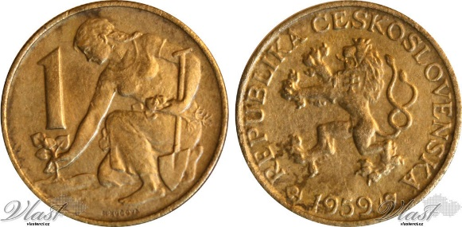

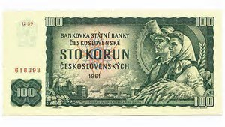
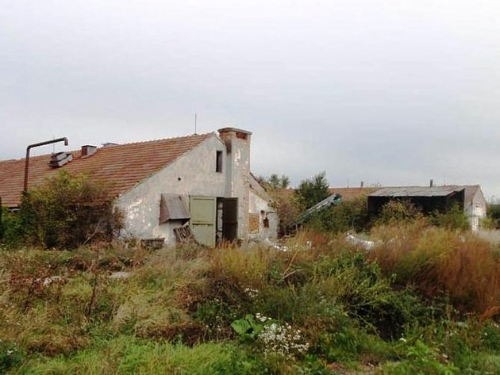
Agricultural capital market development (before and after EU accession)
Before EU accession
Before 1989
United agricultural cooperatives – JRD (since1949)
Strong focus of state to agri-food sector
After 1989
restructuring of ownership relations, privatization
Slovakia – since 1993: significant decline of economical conditions of farms, decline of production – external and internal influences
Rapid decrease of farm animals
Bad production results
After EU Accession (after 2004)
Common Agricultural policy (subsidies, open market, market measures...)
Better production results
Further decrease of farm animals
Situation remains unstable (strong volatility of prices, threat to competitiveness, unfair practices of chains of supermarkets, high production costs, low national subsidies)
CAP post 2020: strong focus to protection of environment, capping, market measures, risk management etc..

Slide 5
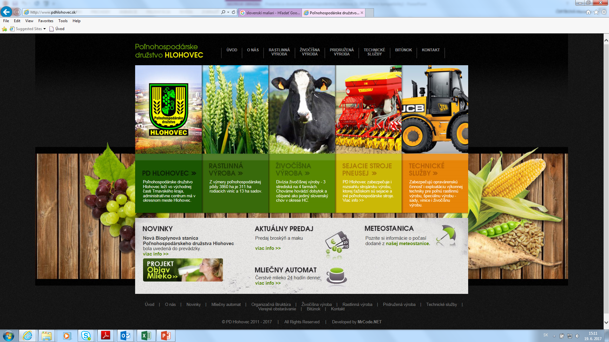

Slide 7
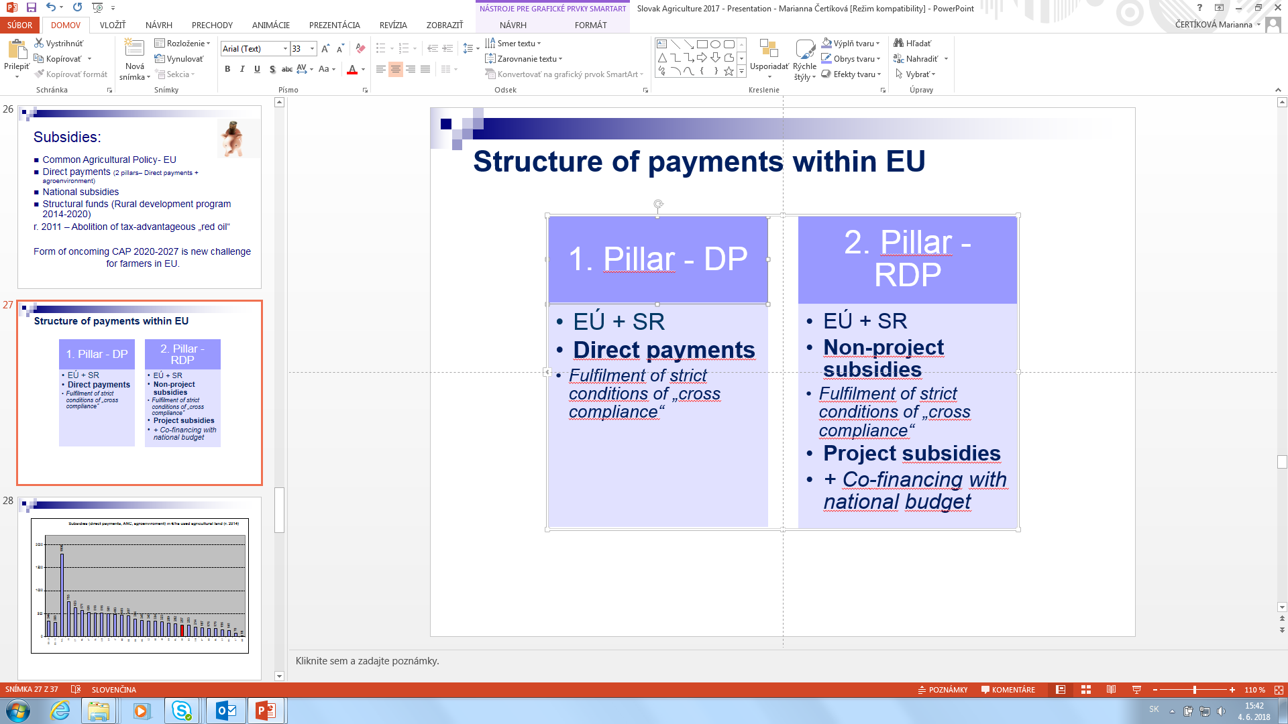
Subsidies of EU -Common Agricultural Policy
1st pillar
2nd Pillar
Amount for EU: 95,58 bln Eur
Amount for SR: 2,08 bln Eur
New CAP: 78,8 bln/1,59 bln Eur
+41,2 mil for support of market measures
Amount for EU: 312,75 bln Eur/
Amount for SR: 3,05 bln Eur
New CAP: 286,2 bln /2,75 bln. Eur

Slide 9
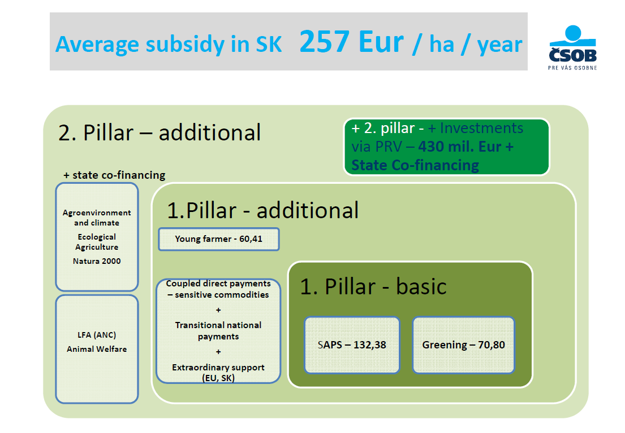

Slide 10
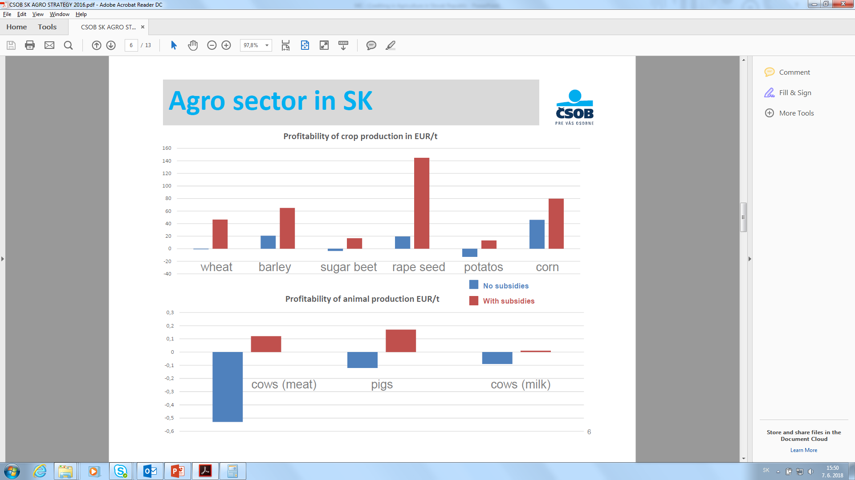

Slide 11
State supported loans and subsidized interest rates
Slovenská záručná a rozvojová banka: Short term, long term credits, restricted but andvantageus conditions, less flexibility
Commercial banks – no subsidized interest rates or state supported loans, nor any state guarantees, more flexibility, low interest rates
State support to farmers:
Green oil (formerly known as „red oil“): 30 mil. Eur/2018
National support (subsidies) to farmers in Slovakia:
1 mil. Eur in 2018!
In 2016 was level of state support in surrounding countries 10- 30 times higher

Slide 12
Guarantee funds in agriculture - how it functions, conditions,procedure and experience
There are no Guarantee funds in agriculture in Slovakia
Talks on „RISK FUND“ :
-covering of unexpected risk on the market – weather, price volatility etc
-co-financing of State, Enterpreneurs (mandatory levy), Insurance companies
- No agreement so far

Slide 13
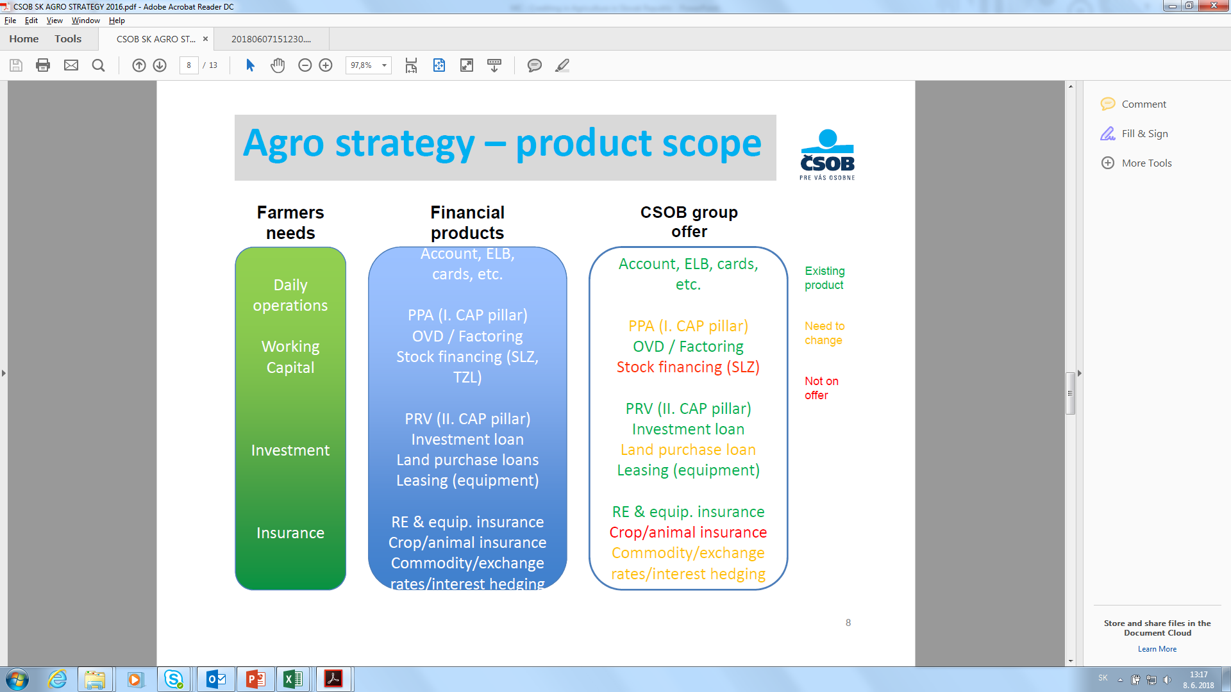
Agricultural credit system in Slovakia

Slide 14
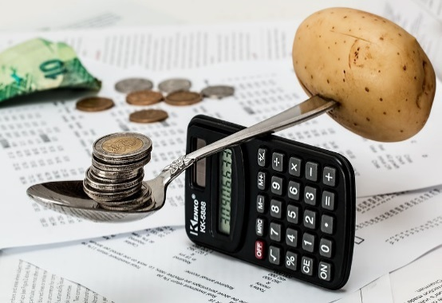
Current state of play of Financing
Long and medium term credits:
Investments (with or without EU funds)
Agricultural land
Aquisitions of farms
Short term credits:
Operational funding (subsidies prepayment, overdraft loan,
Leasing
Insurance

Slide 15
Major conditions (interest rates, repayment period, fees, collateral requirements etc)
SME, Corp, Micro
Short term: 0,5-2,9% margin + Euribor
Long term: 1,6-3 margin + Euribor
Repayment periods:
Short term, medium, long term (up to 20 Y)
Collateral requirements:
Pledge for property, movable property, stock, receivables (pohľadávky), disposal (dispozičné právo) of credit bank account (expert opinion or own assesment of value of collateral)

Slide 16
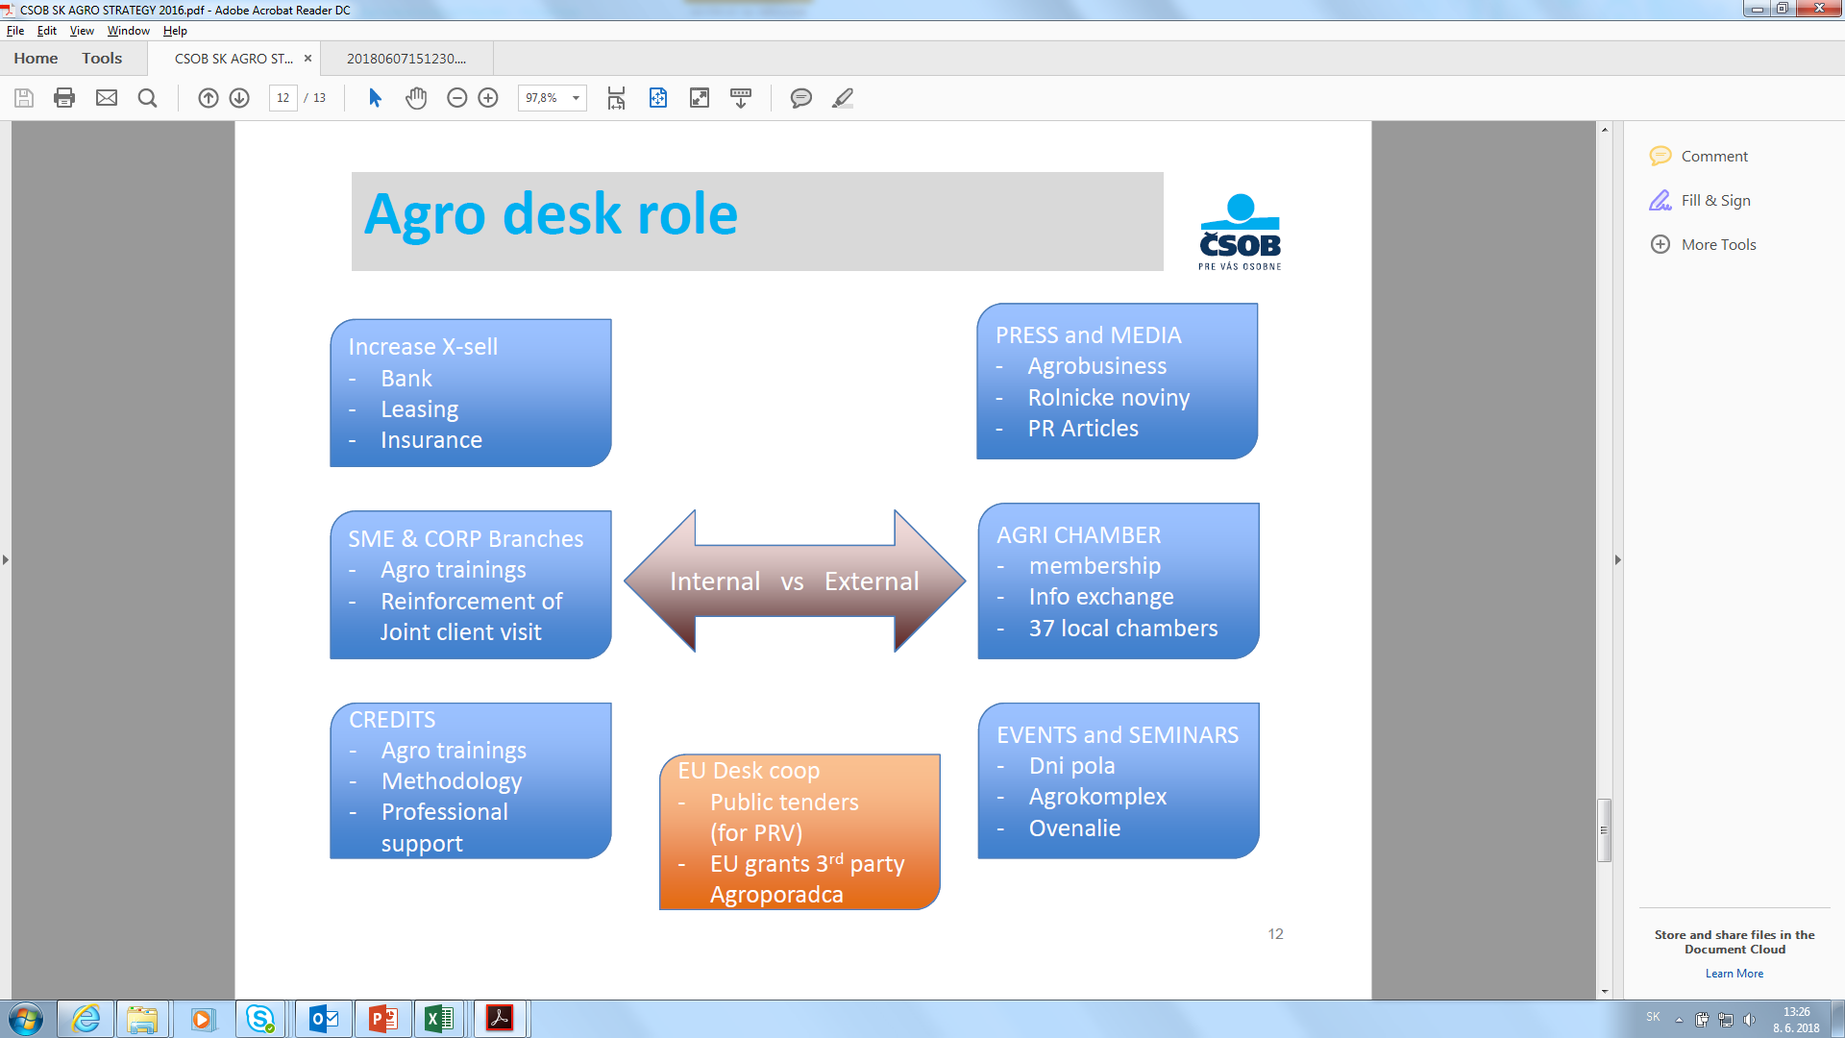
Enhancing business development in the agricultural sector,role of crediting

Slide 17
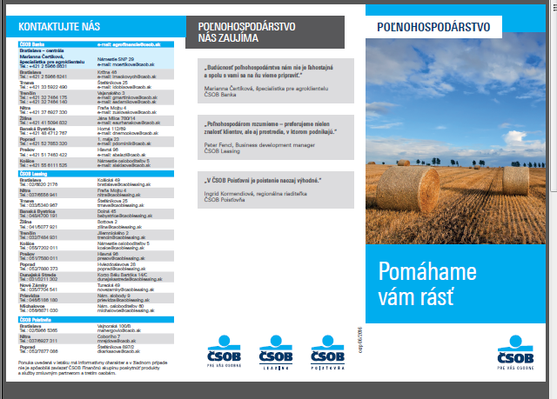
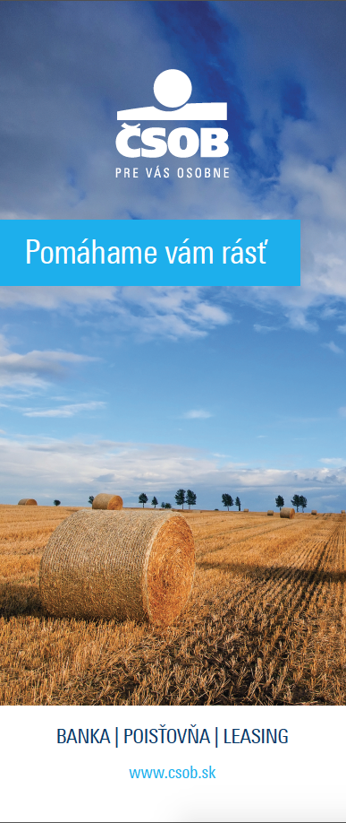
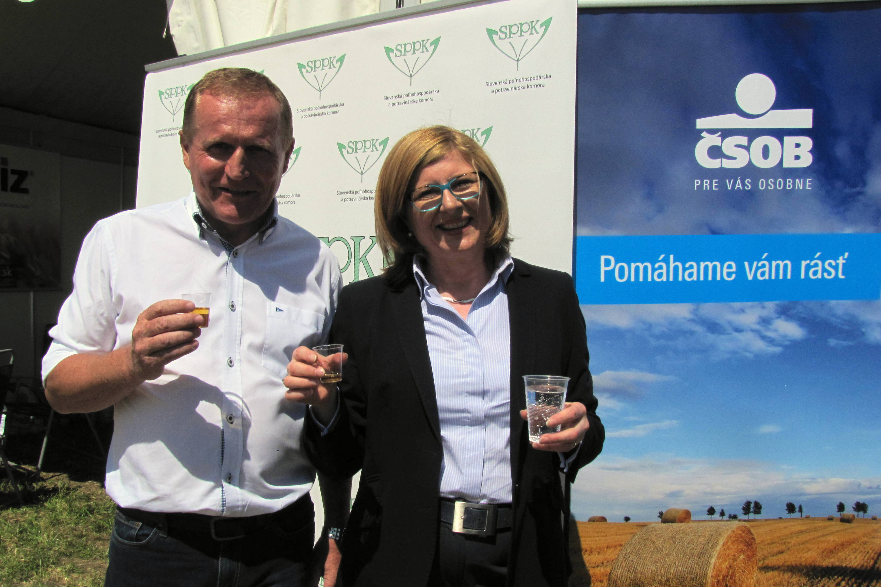
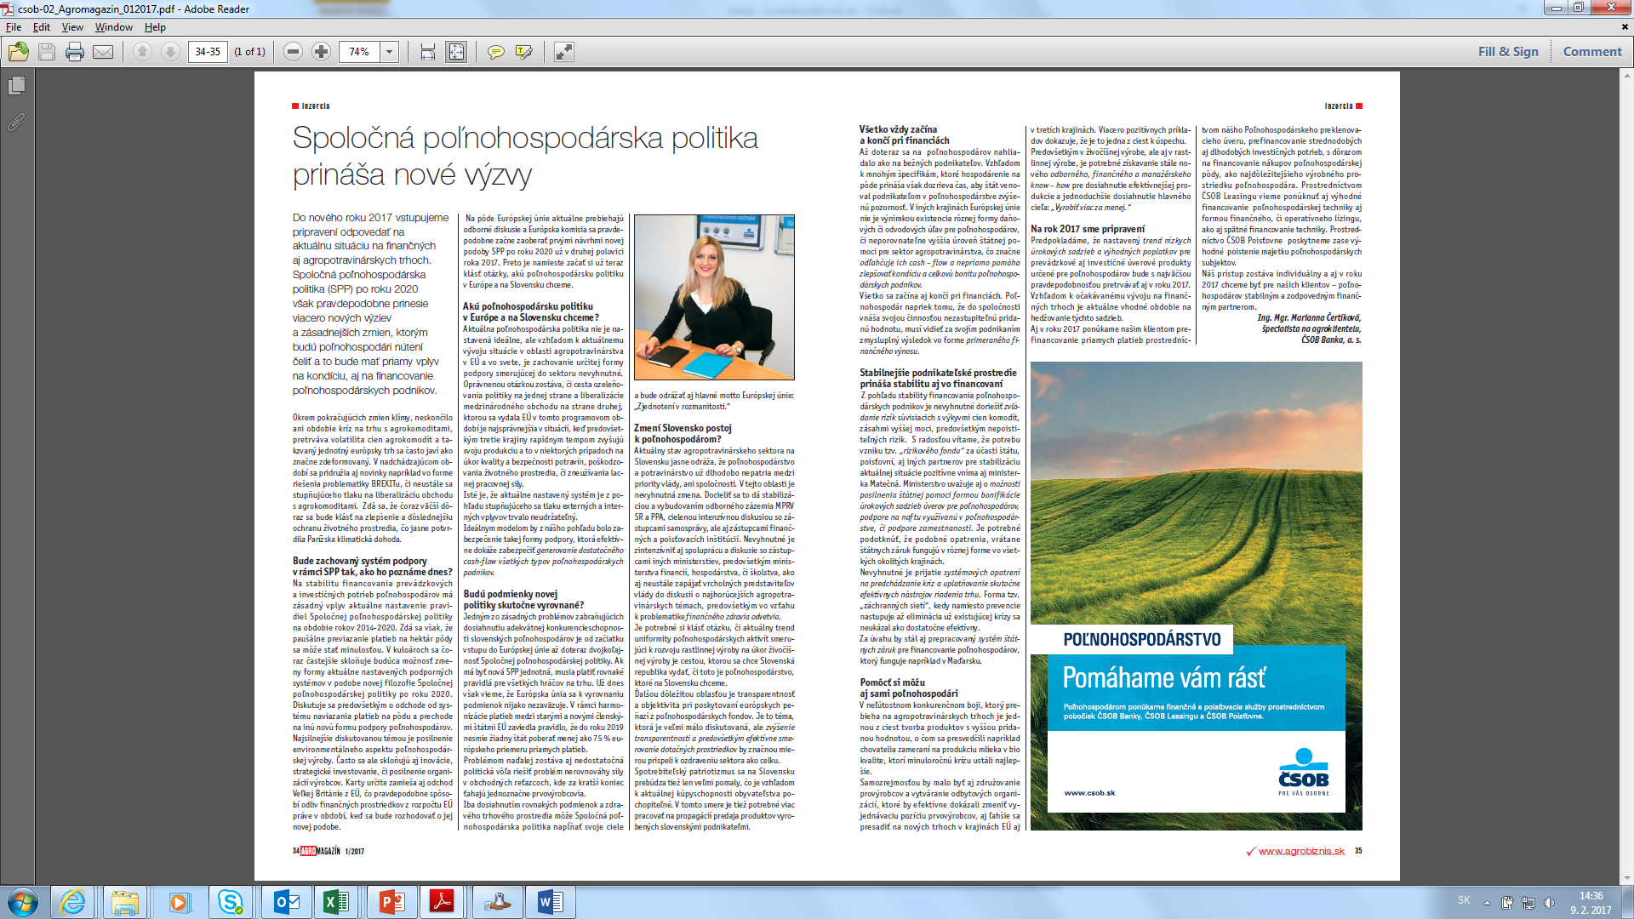
Enhancing business development in the agricultural sector, role of crediting

Slide 18

Thank you for your attention
Ing. Mgr. Marianna Čertíková
Specialist for Agri clients
ČSOB Bank, a. s. (member of KBC Bank)
mcertikova@csob.sk

