Slide 1

AI in Estonian Public Sector
JÜRI KIVIMÄE
ESTONIAN TAX AND CUSTOMS BOARD (ETCB)
Notes:
Ladies and gentlemen, honored guests. I’m here to tell you a story about artificial intelligence in the Estonian Public Sector

Slide 2

About me
Lived in Canada for ~20 years
Background in Computer Science and Anthropology (University of Toronto)
Data Science Boot Camp (Lighthouse Labs)
Over a year at Estonian Tax and Customs Board (ETCB)
Notes:
My name is Jüri Kivimäe. I was born in Estonia but lived for 20 years in Toronto, Canada. There I studied Computer science and anthropology at the University of Toronto. I also completed a data science boot camp at Lighthouse Labs. I Returned to Estonia in 2022 and started work at the Tax and Customs Board early 2023.

Slide 3

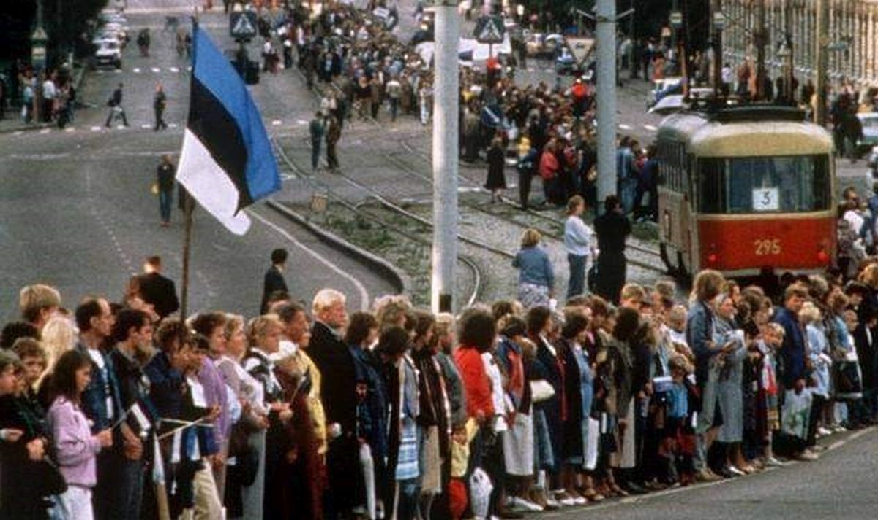
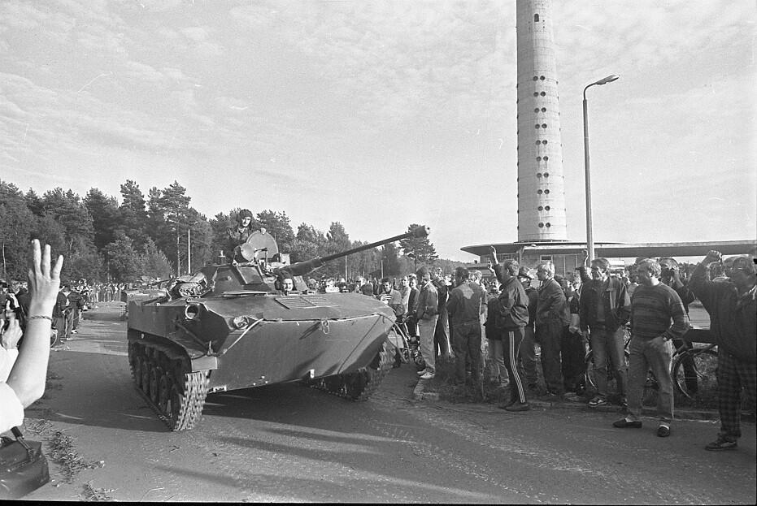
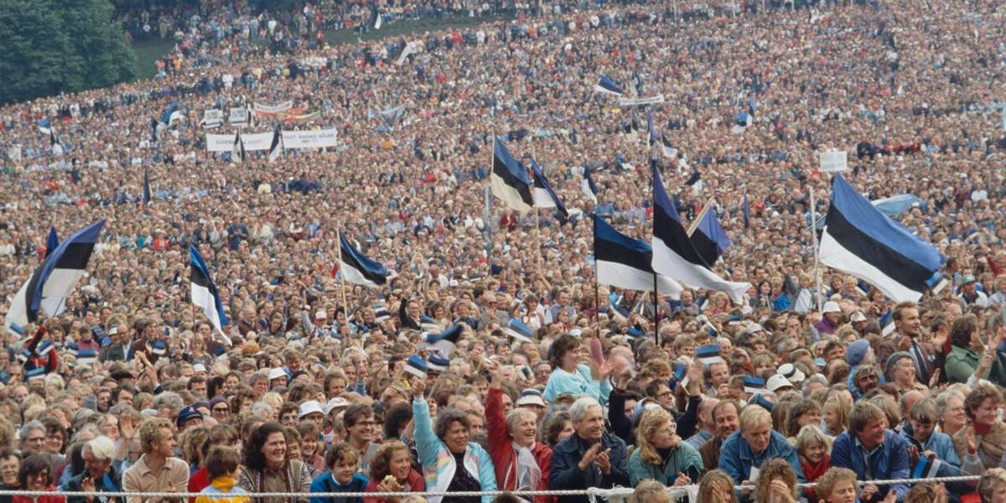
Notes:
In the 90s, former Yugoslavian and Soviet republics gained independence. Having been under communist rule for over 40 years meant that we had fallen behind in many sectors. We had to play catch up really fast.

Slide 4
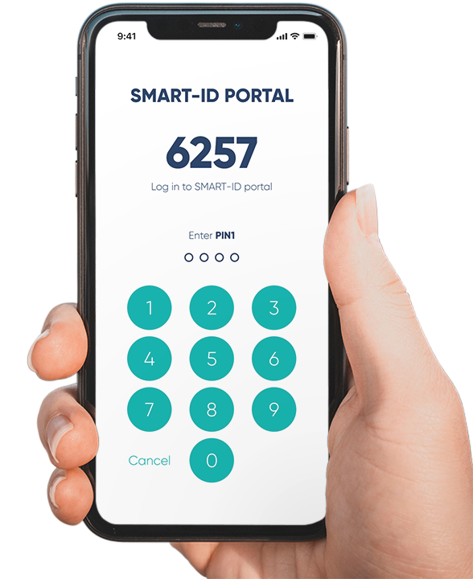


Notes:
This meant catch up for the IT sector as well. In mid 90s there was the Tiger Leap project that invested heavily into Computer and network infrastructure with an emphasis on education. (as seen in the picture)
In 2002 we started issuing ID cards. The cards work as proof of identity but also allowed for digitally signing documents and provided access to an increasing number of online services.
In 2011, mobile ID followed by Smart ID in 2019 were adopted as a phone based method of authentication that did not require the use of the ID card.

Slide 5
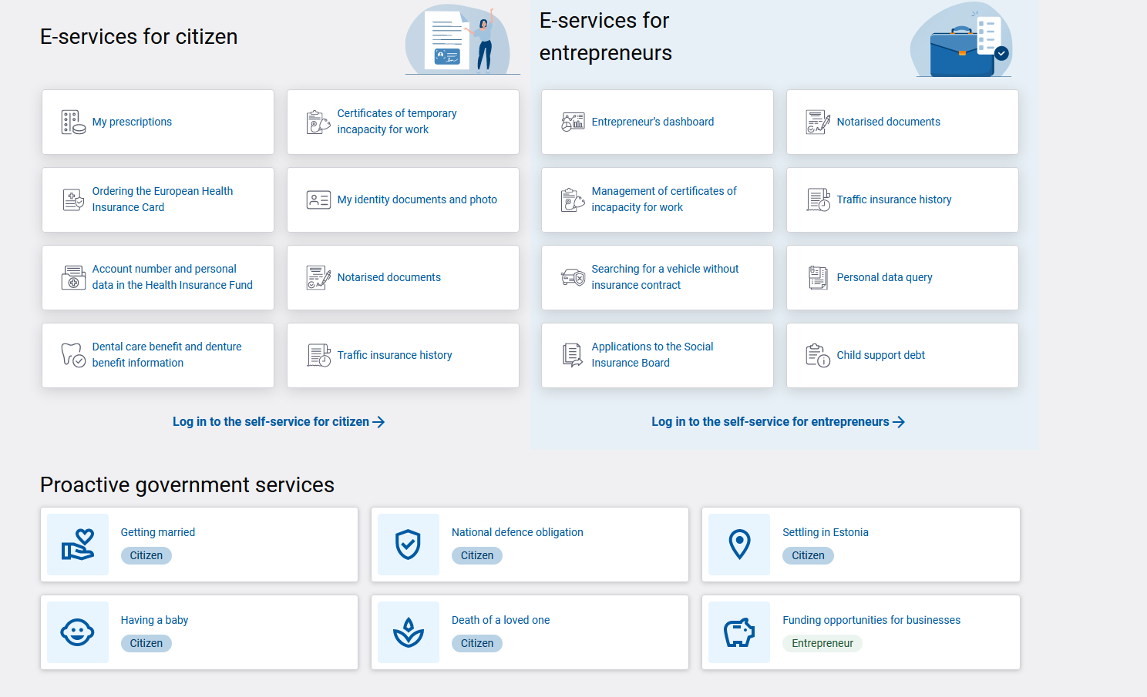
Notes:
In present day, a wide range of public services are available online: you can check your medical and employment records, register your vehicle, register your company, apply for a construction permit. The list goes on.

Slide 6

ETCB - From Paper to Digital
Typing in hand-filled forms
15 button clicks to submit a declaration
Reduced to 5 clicks
Notes:
As the Estonian IT infrastructure grew, we at the Tax and Customs Board grew alongside.
Our interim head of department told us a story: When he started at the Tax Board, one his first jobs was typing in hand-filled declaration forms. Back then we had already introduced digital declarations but it took a minimum of 15 mouse clicks to submit a declaration.
After some development we managed to get the amount of button clicks down to 5.

Slide 7
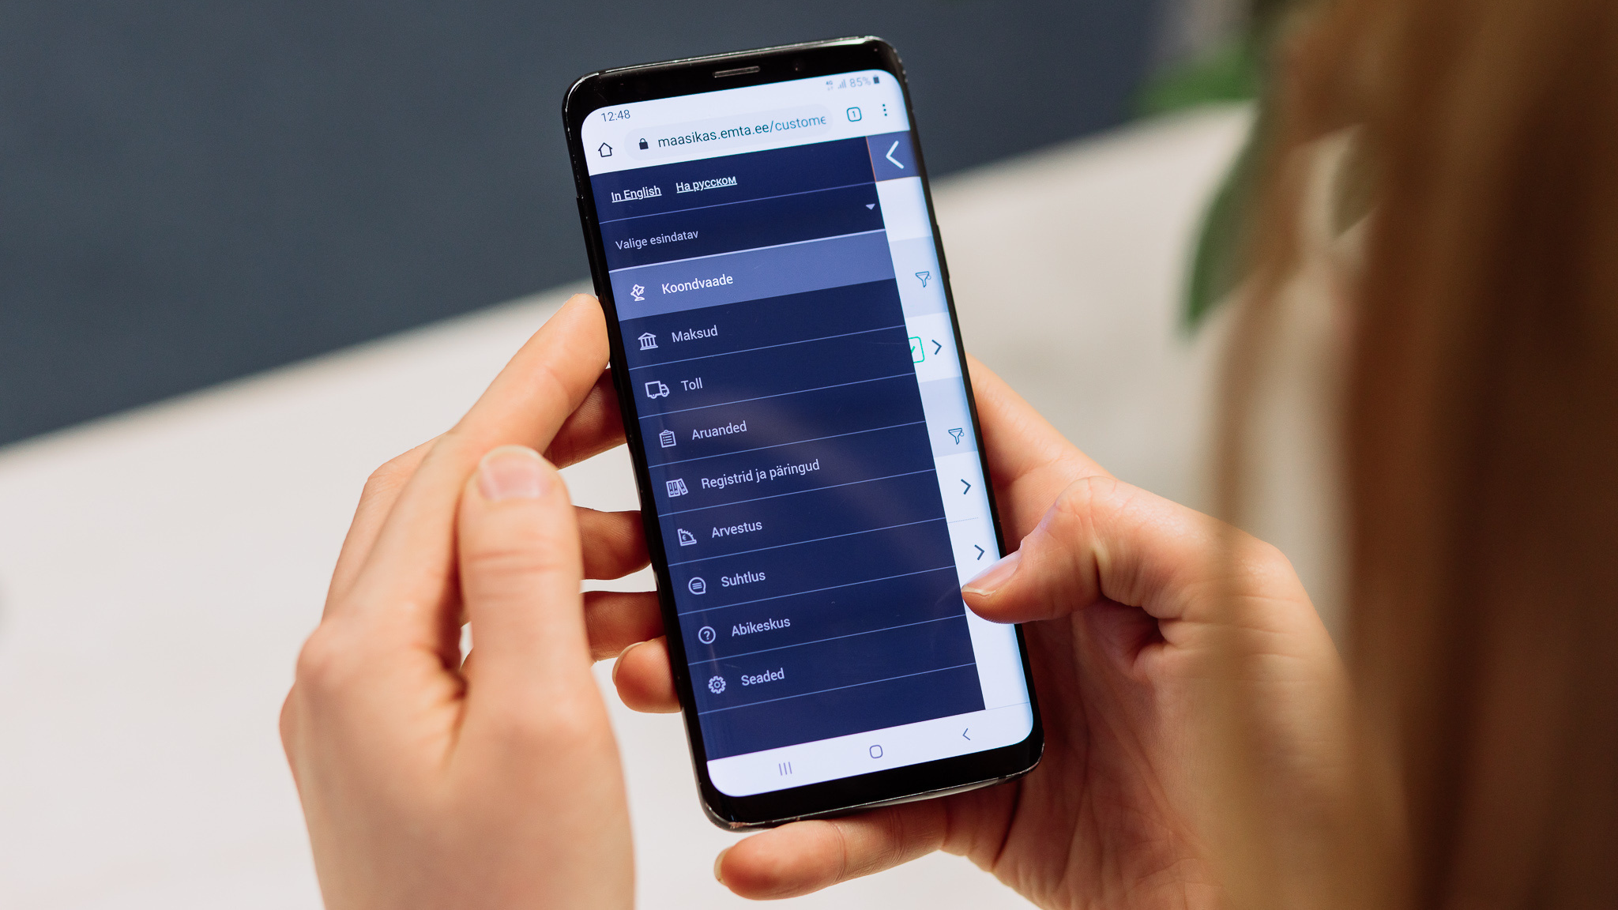
ETCB - From Paper to Digital
Pre-filled forms
One click
Able to do it from phone
Fully automated
Notes:
Next step was automating the declarations by having forms pre-filled using the data we already have.
Nowadays you are able to submit your pre-filled declaration with only one click. And you can do it using your phone.
And with some types declarations you are able to make them fully automated

Slide 8


Timeline of our e-developments
Employment register
Real Time Economy
automated and digitalized
e-customs
e-ETCB stylebook
Tax Behaviour ratings
Prepayment account
2000
2004
2009
2012
2014
2016
2017
2019
2022
2023
2024+
VAT listings
Single Window for e-ETCB
1st electronic tax declaration
e-invoicing
AI
Electronic delivery of documents
Prefilling Tax returns
Electronic registration of construction sites
Notes:
In 25 years we have moved from a basic IT system to having electronic tax and customs declarations, prefilled tax returns and in the near future, real-time economy monitoring.

Slide 9

High Trust in Tax and Customs Administration
Notes:
Our annual surveys shows that there is high public trust for the Tax and Customs Board.

Slide 10
99% of declarations are submitted digitally
30%
60%
95%
99%
2002
2004
2009
2023
Notes:
And thanks to our continuous efforts to make digital declarations convenient to use, 99% are submitted digitally

Slide 11

Data Management
Data Architecture
Pipelines
Data Warehousing
Data Governance
Policies, procedures and standards
GDPR
X-road Data Exchange
unified and secure data exchange between organisations
Notes:
Now, when everything is going digital means we have more data to sift through and analyze. It becomes important to manage the data and not drown in a data swamp.
The need for a data warehousing solution becomes paramount in order to analyze the vast amount of information.
With that also come governing policies and standards how to manage the data such as the GDPR
Secure channels for exchanging data between organizations need to be set up. In Estonia, our solution for this is called X-road. It allows for a standardised way of exchanging data between information systems, be it between government authorities or companies.

Slide 12

AI in Public Sector
Kratt – practical applications based on AI technology.
Tool that saves time or supports decision-making
Natural language processing
Machine translation
Audio transcription
Computer vision
Notes:
An AI application in the Estonian Public sector is called kratt, after a creature from Estonian folk religion that could be created out of anything by anybody with the purpose of acquiring assets for the owner.
Currently there are over 80 kratt’s being used or in development. They support decision making, perform tasks that are time-consuming for humans, if not impossible.
The models are based on natural language processing, machine translation, audio transcription, Computer vision, to name few

Slide 13
AI in Public Sector
Automatic real time subtitles for TV programs
Detection of land mowing using satellite imagery
Transcription of emergency calls
AI virtual assistent
www.kratid.ee
Notes:
A couple examples:
Our state media uses a kratt for creating real time subtitles for TV programs.
The agricultural authority uses satellite imagery to detect if farmer have mowed their land (because they get subsidies based on that)
Emergency services uses a tool to transcribe incoming calls
We have an AI virtual assistant that can be customized for a government authority web page

Slide 14

VAT Refund data mining (2019)
Find incorrectly submitted VAT refund claims
Model output complements existing risk model
Developed in-house
Notes:
And with this in mind, the Tax and Customs board also has a history of AI projects AI projects.
In 2019, we developed a data mining model in-house. Its purpose was to detect incorrectly submitted VAT refund claims, whether accidentally or deliberately incorrect
The model output is used alongside existing risk models
Present day the model is still in use but its output is not as impactful. The person who developed it left the Tax Board and the model and the model has not been maintained ever since.

Slide 15
Envelope Wages POC (2020)
Can an AI model be more effective than a rule-based model?
97% accuracy!
Developed by external contractor
Notes:
In 2020, we contracted a developer to create an AI model for detecting envelope wages (undisclosed income). The goal was to establish whether an AI model can be effective than an existing rule-based risk model.
And the answer was yes, it can! Model accuracy was 97%
This model did not make it into production due to technological and organizational issues. But it served as proof of concept.

Slide 16
PEOPLE
TECH
PROCESS
ETCB AI Strategy (2021-2022)
AI readiness can be assessed in six areas
STRATEGY
Assess AI readiness
Map key processes and bottlenecks
Identify AI use-cases
Prototyping
Financing by EU (TSI), execution by Deloitte
Available online
DATA
ETHICS
Notes:
In 2022, an AI strategy was developed for the Tax and Customs board. The strategy was funded by EU and executed by Deloitte
The goal of the strategy was to improve our capability for reforms related to artificial intelligence
It assessed our AI readiness in areas shown to the right,
Identified our key processes and bottlenecks
Identified potential AI use cases and created prototypes for 5 likely candidates.

Slide 17

Explored AI Concepts at ETCB
HS code classification
Automatically assign HS code based on item description
Customs declarations fraud detection
Risk assessment of declarations
Detect anomalies
Notes:
There were two projects that got started but did not make it past the concept phase:
HS code classification
and fraud detection in customs declarations.

Slide 18
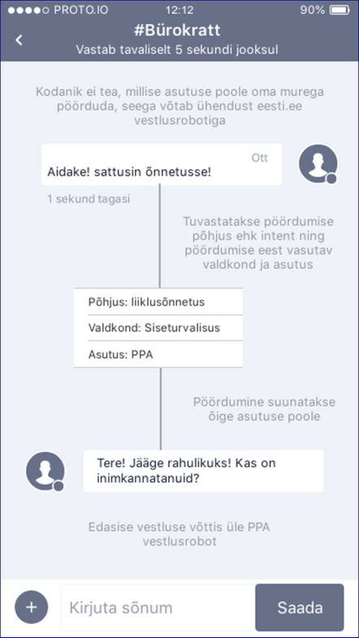
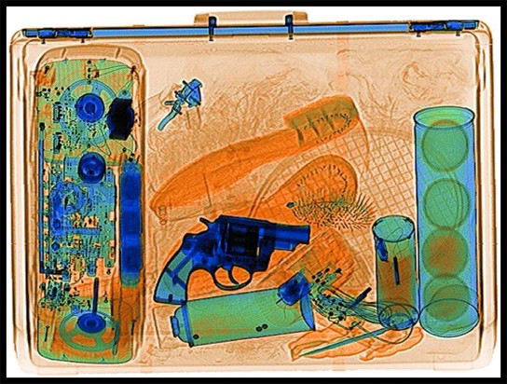
Ongoing AI Projects
AI virtual assistant Customs X-ray image classification
Notes:
On to current projects.
The AI virtual assistant that i mentioned before has been integrated into our website. It is presently available only during the workdays so that we can monitor it. So we can make sure its not hallucinating.
And were working with a contractor to create a model to assist us with classifying X-ray images at Customs checkpoints.

Slide 19
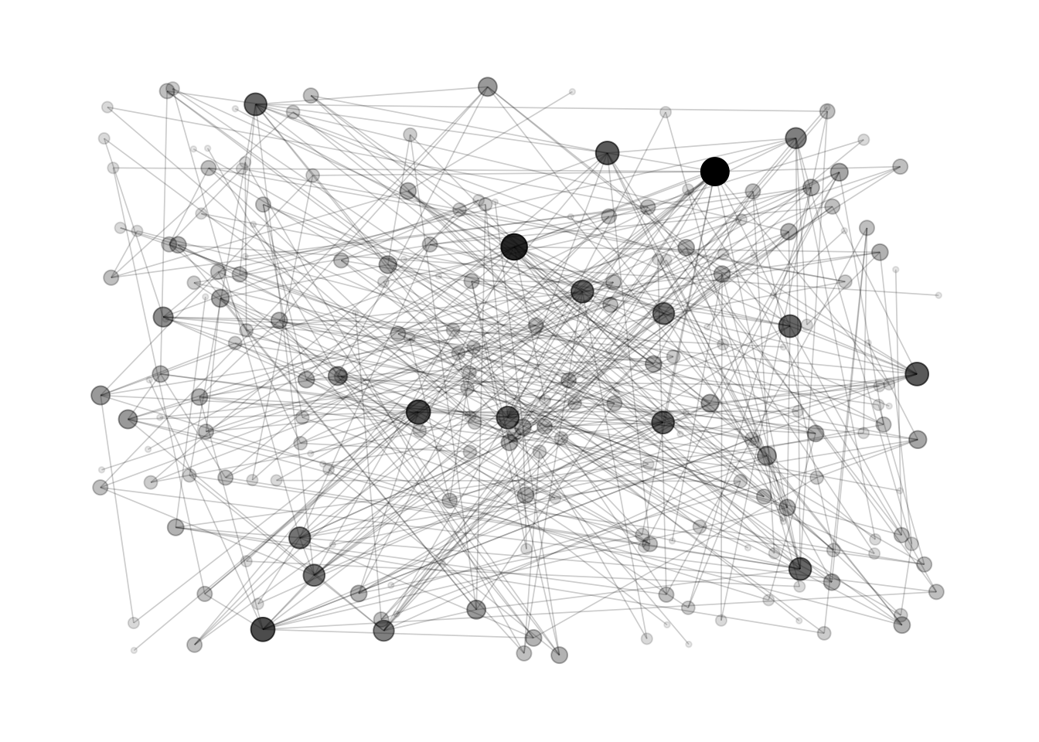

Ongoing AI Projects
Network Analysis (2024)
Map relations between persons
Map risks
Neural Network
Discover anomalies and fraud patterns
Faster audits
Notes:
Our most recent project is Network-based risk analysis.
To accomplish this, we would map the different kind of relations between persons: employer-employee, transactions between parties, who is on the board of different companies etc
We then would map the results of our risk models on the persons or the relations
Our aim is that once this network is created, we can apply a a neural network model in order to discover new fraud patterns
One of the motives behind this project is to help speed up audits.

Slide 20
Creating AI Competency
Hardware and Environment
On-premises
Control & Security
Large Capital Expenditure
Expensive to scale
Public Cloud
Low CapEx (pay-as-you-go)
Higher operational expenses
Data sensitivity
Scalable
Notes:
Before you get to having AI systems you need to make some choices
You have to decide how you set up your AI environment.
If you set it up on-premises locally, there will be more capital expenses but it will be contained. However, if the number of your AI models grows and the hardware reaches it limit, it will be an additional cost
Whereas if you choose to go with a public cloud like Amazon AWS the capital expenditure will be small but on-going operational expenses may be higher. There may be hesitation to uploading sensitive data to the cloud.

Slide 21

Creating AI Competency
Problem
Data Preparation
Model Development
Model Deployment
Monitoring
Contractor
Experienced data scientists
Data sensitivity
Model maintenance
In-house
Secure and customizable
Requires in-house competency
Pre-made software (Nexyte, Datawalk)
Cost-effective
Limited customization
Notes:
How will you develop the AI models?
You can contract it out to a company that has good track record of creating AI models. But data sensitivity if going to be an issue. And are they going to be maintaining and retraining your model?
You can develop it in-house but that requires data scientists and machine learning engineers and theyre not cheap. And what if they leave?
There exists a number of pre-packaged applications such as Nexyte and Datawalk that can be integrated in your existing systems. It has the potential to be cost-effective but they may not be suited for your specific needs. Also here ´is the issue of data sensitivity.

Slide 22

Issues
Data Privacy and Security
Transparency
Data quality
AI a solution looking for a problem
Notes:
In order to maintain public trust and compliance, Data privacy and security is critical to protect sensitive information from unauthorized access or breaches
When we are dealing with more complex AI models such as neural network models, there is the issue of transparency. Can we explain why our model produced a certain result?
Data quality is paramount. In the data science community the saying is ‘garbage in, garbage out’. If our input data is incomplete or unbalanced, then so will be the result of the model.
And last but not least: In the midst of the AI hype, it has become a solution looking for a problem. Many people are overly eager to apply AI to everything without understanding the specific issues that need to be addressed.

Slide 23
Support
Use cases in EU public administrations
Big Data Test Infrastructure (BDTI)
Cooperation and collaboration
ICS2 Joint projects
Fiscalis workgroups
Notes:
AI systems have been developed or are in development in public administrations all over EU.
Many of our AI projects were influenced by the successful deployment of AI projects by Tax authorities in other European countries.
Furthermore, the European Union offers support in various forms:
An example being Big Data Test Infrastructure, a ready to use analytics cloud stack using open source software, intended for public administrations
Within the EU there is a lot of collaboration and cooperation with respect to the use of AI. For example, I’m part of a ICS2 workgroup where our goal is to build AI models to help with customs.
The fiscalis programme has several workgroups, among them an AI workgroup where we share knowledge about using AI in taxation.

Slide 24

The AI Journey is best taken together!
Notes:
And that concludes my presentation.

