Slide 1
NATIONAL CONVENTION ON THE EUROPEAN UNION IN NORTH MACEDONIA
“The data we trust:
A prerequisite for a stronger economy and an effective fight against corruption”

Slide 2
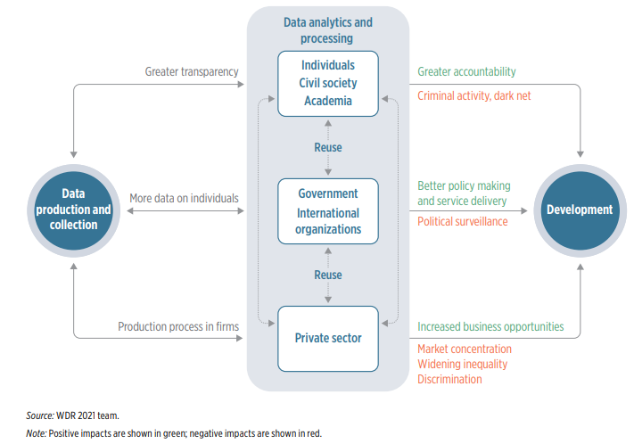
Why is accurate, reliable, timely, complete and consistent data important?
Allows policymakers to make informed decisions about resource allocation, policy formulation, and program implementation.
Promotes accountability and transparency by informing citizens that can hold their governments accountable for their actions and use of public funds.
Unlocks economic opportunities by providing an environment that can attract more investment and boost economic activity.
Enables progress on the EU accession agenda as a strategic anchor that supports the country’s development objectives.

Slide 3
Good economic policies rely on good macroeconomic statistics
Macroeconomic statistics need to improve in consistency, timeliness and coverage of the excessive deficit procedure and government finance statistics, as well as to further align financial accounts and quarterly national accounts with the European System of Accounts 2010 (ESA 2010).
      Sector classification of general government (notably market/non-market test)
      Time of recording (application of general accrual principle, generally differs from public accounting)
      Financial transactions (no impact on deficit) versus non-financial transactions (impact)
      Special or innovative transactions
      Exhaustiveness, coherence and accuracy of data (revisions, growth rates)
Some fiscal data still labelled as “experimental” and “non-publishable” or “confidential”
Completeness and quality of data issues on quarterly GDP by income approach (not published)
Macroeconomic forecasts are as accurate, reliable and realistic as their input data

Slide 4
Social statistics form the foundation of sustainable development
Good progress was made with the finalization of the population census that is the backbone of social statistics. Censuses provide an essential statistical input for formulating and evaluating policies, for administrative purposes and for conducting research.
More and continued efforts are needed to improve the scope and data quality underpinning social statistics.
In particular, timely submission to Eurostat and dissemination of survey data is noted in the last progress report.
      Delayed results of SILC, LFS and labor cost surveys
Good quality social statistics, when combined with economic and institutional statistics, are essential for formulating equitable, efficient, and tailor-made social and regional development policies, leading to improved social outcomes and more balanced regional development.
In the future, social, economic, and institutional data are going to be indispensable for effective programming
and allocation, as well as for transparent monitoring and evaluation for the use of EU cohesion funds.

Slide 5
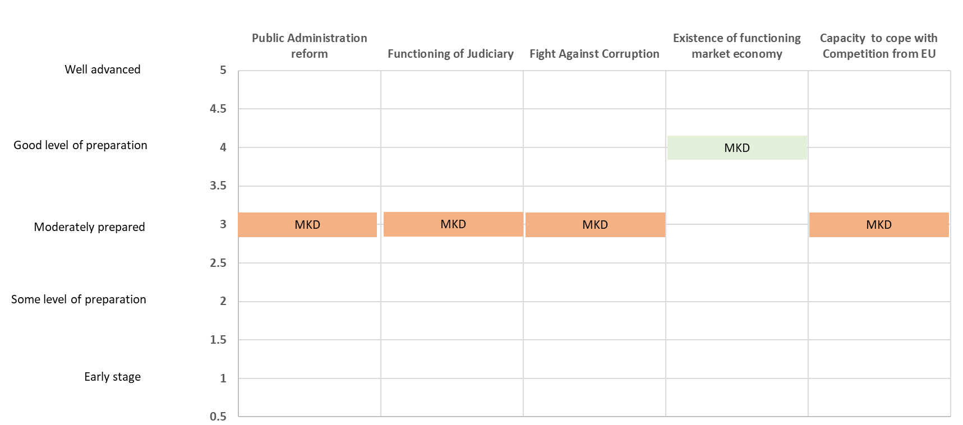
Limited progress on the governance agenda also holds back the EU accession progress

Slide 6
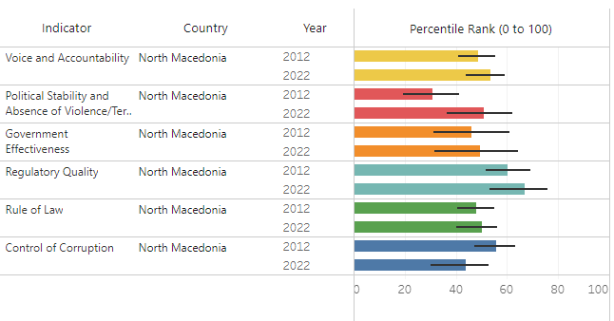
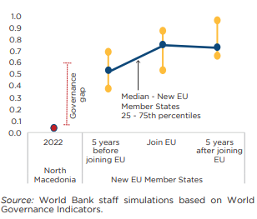
Despite some improvement, the progress gap between North Macedonia and EU peers remains wide
In the last decade, North Macedonia’s performance improved across all governance indicators, except control of corruption
However, the gap between North Macedonia and EU peers remains wide, particularly with EU member states when compared at the same stage of the accession process
Source: World Bank Governance Indicators.

Slide 7
Annex: WGI methodology
Each of the six aggregate WGI measures are constructed by averaging together data from underlying sources that correspond to the concept of governance being measured.
Individual indicators from underlying data sources are assigned to one of the six WGI measures, rescaled to run from 0 to 1, and integrated in an Unobserved Components Model (UCM) to construct a weighted average of the individual indicators for each source.
The composite indicators are in units running from approximately -2.5 to 2.5, with higher values corresponding to better governance.
The composite indicators are also reported in percentile rank terms, ranging from 0 (lowest rank) to 100 (highest rank).

Slide 8
Thank you for your attention!

