Slide 1

THROUGH PROFESSIONALISM AND INTEGRITY TO TRANSPARENCY AND ACCOUNTABILITY IN POLICING Skopje 8 July 2024 Odd Berner Malme

Slide 2


ABOUT GI-TOC
The Global Initiative is an independent civil-society organization, headquartered in Geneva, Switzerland, with a globally dispersed Secretariat and a high-level advisory board.
and Serbia.

Slide 3
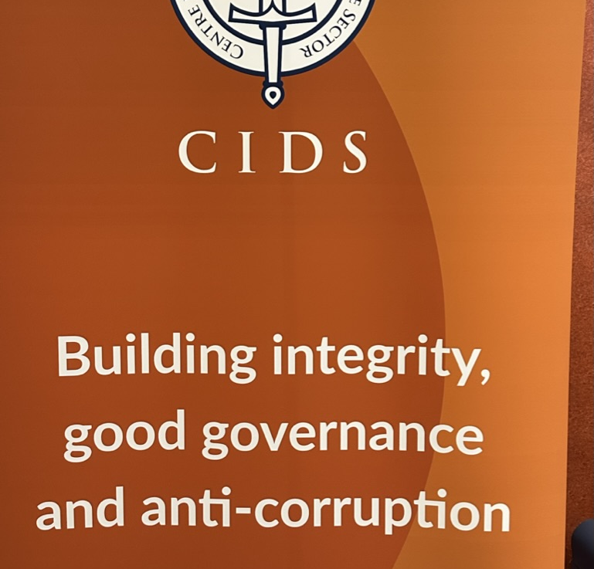
CENTER FOR INTEGRITY IN DEFENCE AND SECURITY SECTOR
NORWEGIAN GOVERNMENT REGIONAL PROJECTS IN WESTERN BALKANS IN GOOD GOVERNANCE.

Slide 4


Slide 5

Notes:
The police service operates on the basis of openness and transparency. This is essential to develop and enhancing relationship between the policing profession and the community. However sometimes necessary to use covert tactics. This is recognised in law and must be appropriately authorised.
My experience is that the countries in the region have a history where most of the information was classified. There is still a lack of culture of transparency. This makes it difficult to exchange information with international partners.

Slide 6


Notes:
Accountability is a crucial aspect of modern policing, ensuring that law enforcement agencies and officers are responsible for their actions and decisions. Here are the key points about police accountability. The main goals of accountability are to prevent police misconduct, enhance public confidence, and maintain police legitimacy.

Slide 7
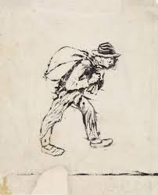
INTEGRITY IN POLICING
Notes:
Police integrity is a crucial aspect of effective law enforcement and maintaining public trust. Police integrity refers to officers consistently behaving in accordance with ethical values and professional standards, both on and off duty. In few words Integrity is to do the right things.

Slide 8
Operational Independentes of Police
Operational independence means that police have the authority and discretion to make decisions about day-to-day operations, including how to deploy resources and conduct investigations, without direct interference from political actors.
Balance with accountability: There is an inherent tension between preserving police operational independence and ensuring democratic accountability to the political echelon and the public. The police cannot operate without political oversight.

Slide 9


Operational Independentes of Police
Some of the remarks in the latest GRECO Report refer to the Ministry of Interior (MOI). From the very beginning, there have been concerns about the politicization of the police.
The latest GRECO Report discusses concerns regarding the Ministry of Interior (MOI) and its potential politicization of the police
GRECO identified an issue with the command system within the MOI, where the Minister of Interior has the authority to direct police forces, deviating from European norms where such authority typically lies with a police commissioner.
As a response, North Macedonia is urged to bolster the operational independence of the police from the Ministry of Interior and ensure that individual police officers carry out their duties impartially and under existing rules on integrity and without political affiliation.

Slide 10
Strengthen Operational Independentes of Police
The police's organizational connection is important in relation to independence.
The Police Director and Assistants should be in their positions regardless of elections and changing governments. They should be appointed for a certain periods based on their competence and professionalism and not elected.

Slide 11

Devastating to the Trust in Policing
CORRUPTION
ABUSE OF POLICE POWER

Slide 12
Corruption
Devastating to the Trust in Policing
"Corruption is the abuse of power in trusted positions for personal gain".

Slide 13


Targeted Areas of Corruption Risk in Police Administration:
A complicated yet functional mechanism for investigating corruption and organized crime in Police Administration. Plan for Integrity outlined in GRECO report 2023 targeting six key areas susceptible to corruption within MoI. Identified areas and associated risks:
Human resources management
Implementation of public procurement procedures
Excessive use of force when applying police authorizations
Acceptance of bribes by traffic and border police officers
Abuse of official position by authorized officials handling administrative services directly involved in citizen interactions

Slide 14
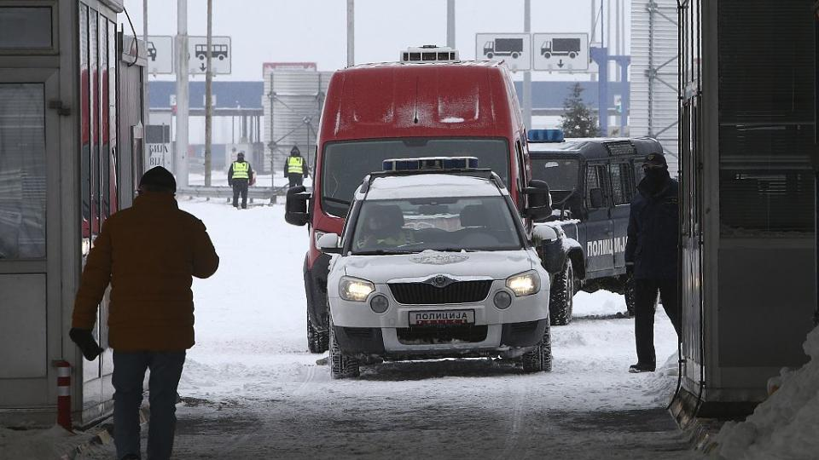
North Macedonia arrests nine border police officers for corruption

Slide 15
NORTH MACEDONIA
CITIZENS CONCERNED WITH CRIME, CORRUPTION AND ECONOMY
Challenges include lack of public trust in institutions fighting corruption

Slide 16
As regards the operation of the police in the Republic of North Macedonia, the prevailing viewpoint in the evaluation of all measured aspects need improvement.
30% are of the opinion that the police are professional in their operation;
26% are of the opinion that they are efficient;
22% that they are transparent;
20% that they are accountable;
16% that they consider citizens’ opinions and requirements in the decision-making processes pertaining to their operation
13 % police are independent from any political, governmental or business-related interests.

Slide 17
Devastating to the Trust in Policing
International expectations
North Macedonia has faced significant international pressure and expectations to combat rampant corruption within its institutions and political system.
The European Union has consistently highlighted the need for North Macedonia to make substantial progress in fighting corruption as a key requirement for advancing its EU accession process.
The United States has also been vocal in urging North Macedonia to intensify its anti-corruption efforts. The U.S. Ambassador to North Macedonia has explicitly stated that Washington expects to see corrupt actors brought to justice.

Slide 18
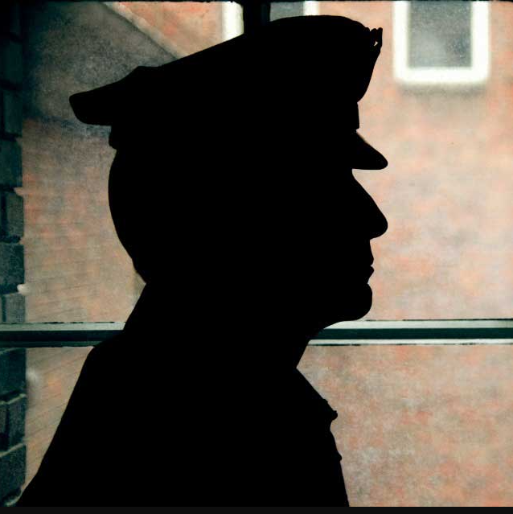
Lead by Example: A cornerstone in Ethical leadership and Preventing Corruption in Law Enforcement
Leaders, through their actions and behavior, set the standard for ethical conduct, creating a culture that rejects corruptions at all level.

Slide 19

CORRUPTION PERCEPTIONS INDEX
2023
EASTERN EUROPE AND CENTRAL ASIA
NORTH MACEDONIA
Score42/100
Rank76/180

Slide 20

WHAT IS THE GLOBAL ORGANIZED CRIME INDEX?
1

Slide 21

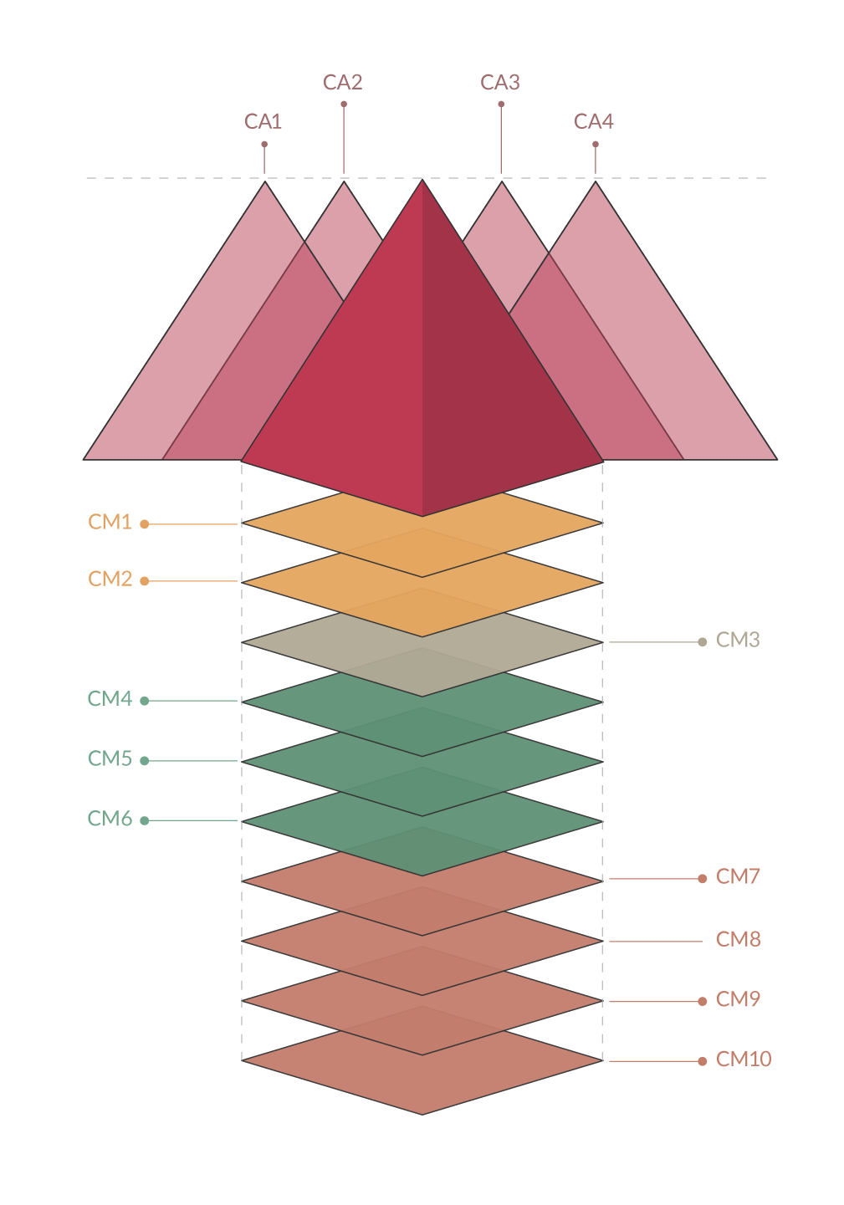
INDEX COMPONENTS
RESILIENCE ‘BUILDING BLOCKS’
CRIMINAL ACTORS
CRIMINAL MARKETS
Notes:
Modeling an index is no easy feat. The inherently clandestine nature of OC, with its ever-changing forms and environments carry the risk of the Index becoming an overly complex tool. At the same time, oversimplifying the Index would risk sacrificing the kind of nuanced analysis needed to inform stakeholders of the conditions within their countries. In turn, that would obstruct the development of effective anti-OC strategies. So we’ve tried to not over-complicate the tool, but also provide a more thorough picture of the OC environment in different context by measuring both criminality and resilience, as they are interrelated. And so, the Global OC Index is based on 3 elements
The scope, scale and impact of specific criminal markets (10 of them)
The structure and influence of criminal actors (4 criminal actor types)
The existence and capacity of countries to be resilient to OC (measured across 12 resilience building blocks)

Slide 22
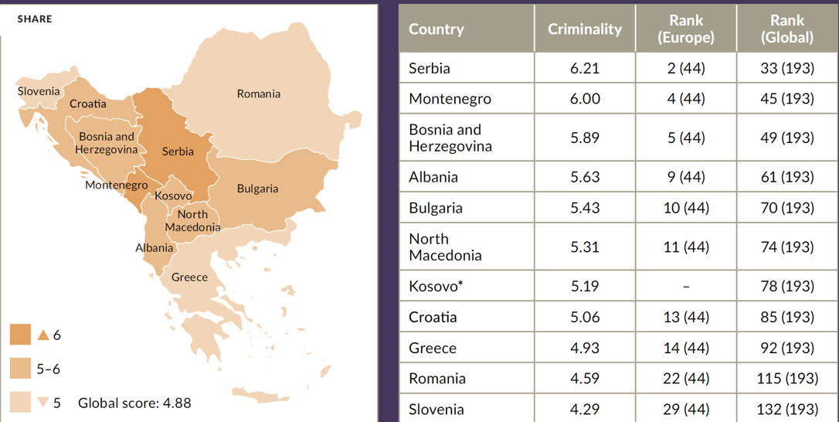
Main criminal markets

Slide 23
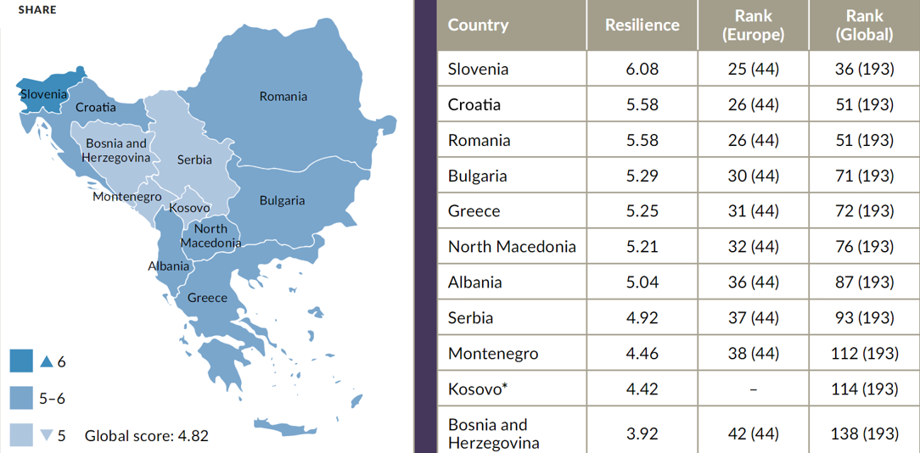
Weak resilience

Slide 24

RED BUTTON App
ЦРВЕНО КОПЧЕ
Почитувани граѓани,
Апликацијата “Црвено копче“ е наменета за пријавување какви било сознанија или информации од областа на злоупотреба на деца*, криминал од омраза и повикувањето на насилство, како и трговијата со луѓе.
Секое лажно пријавување е санкционирано со Кривичниот закон на РСМ - како кривично дело.
Апелираме за случаи кои се итни или за кои постојат докази дека се вршат во моментот граѓаните наместо понудената апликација, тоа веднаш да го пријават на телефонскиот број 192.
* дете жртва е секое дете на возраст до 18 години
ПРОДОЛЖИ / СЕ СОГЛАСУВАМ

