Slide 1
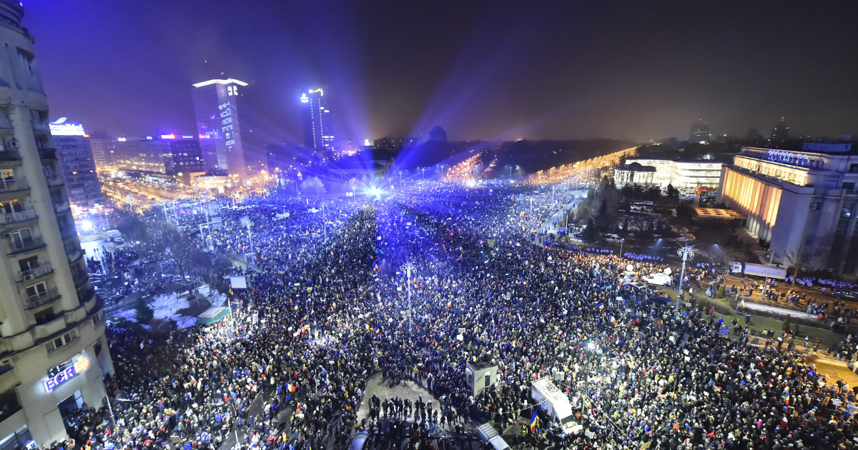



(De)Criminalising Abuse of Power
Learning from Romanian Misfortunes
Cristian Ducu, PhD
Skopje | July 3, 2024

Slide 2
Laws are permanently changing and politicians always seek ways to improve them or not.
The national legislation, the Criminal Code in particular, should be living documents, but democracy requires:
transparency
consultation
predictibility
accountability
awareness
consensus
legitimacy

Slide 3
Abuse of office (old vers. NCP)
“The action of the public servant who, while carrying out their professional duties, fails to implement an act or implements it faultily, thus causing damage or violating the legitimate rights or interests of a natural or a legal entity, shall be punishable by no less than 2 and no more than 7 years of imprisonment and the ban from exercising the right to hold a public office.”
Romanian Criminal Code
(Law 286/2009, art. 297(1))

Slide 4
The Toxic OUG 13 (& seq.)
In January 2017, the Romanian government proposed the emergency ordinance no. 13, which included a form of decriminalisation of abuse of office:
“The action of the public servant who, while carrying out their professional duties, knowingly, carries out an act with the breach of express provisions of a law, ordinance or emergency ordinance, and thus causing material damage higher than 200.000 lei (50.000 Euro) or serious, certain and effective violation of the legitimate rights or interests of a natural or a legal entity, as they are provisioned and guaranteed by the existing laws, shall be punishable by no less than 6 months and no more than 3 years of imprisonment or a fine.”

Slide 5
The Toxic OUG 13
It introduced:
a special condition: to act “knowingly”
another special condition: to be a legal breach
special conditions for damate:
  “material damage”
  a threshold (50.000 Euro)
  it excluded the jurisdiction of the National Anticorruption Directorate (Mrs. Kovesi)
specific conditions for violation of rights: serious, certain & effective
lower punishment

Slide 6
Abuse of office (new vers. NCP)
“The action of the public servant who, while carrying out their professional duties, fails to implement an act required by a law, an ordinance of the government, an emergency ordinance or another normative act which had the power of law at the date of its adoption or implements it breaching a requirement from such a normative act, thus causing damage or violating the legitimate rights or interests of a natural or a legal entity, shall be punishable by no less than 2 and no more than 7 years of imprisonment and the ban from exercising the right to hold a public office.”
Romanian Criminal Code
(Law 286/2009, art. 297(1))

Slide 7
Conceptual problems
1. `Abuse of office’ or ‘Abuse of power’?
(NB: There is also ‘Abuse of authority’)
2. Should be restricted to “public servants”
or should public officials be included too?

Slide 8


demand
supply
abuse of power
a private interest
entrusted power
money, goods, services
opportunity of
abuse of power
illegal transfer of benefits

Slide 9
Conceptual problems
3. Is it just ‘a crime’ or is it a form of corruption?
4. ‘Result-oriented’ or ‘Danger-oriented’ crime?
(Focused on the damages and violations of rights
or on the danger of perverting the entrusted power?)

Slide 10
Another toxic proposal
2023 - a group of Romanian MPs introduced a new proposal aiming to change the definition of the ‘abuse of office’ by raising the penalties to 3-10 years when results in a harm to a personal interest
but the list of ‘personal interests’ included:
“when it causes a major interruption in the activities of
an entrepreneur, i.e., legal or natural person.”

Slide 11

Thank you!
Cristian Ducu
© 2024, Cristian Ducu
All rights are reserved. This material cannot be distributed, reused, published or printed, partially or in its entirety, on any kind of support (paper, digital, etc.) or device without prior written permission of the copyright holder.
cristian.ducu@etica-aplicata.ro

