Slide 1

Spending Reviews and the Proposed model for North Macedonia
NCEU-MK 6th session
Sanja Madzarevic Sujster, the World bank
Skopje, July 17, 2025

Slide 2

What Are Spending Reviews (SR)?
OECD definition: Tools for systematically analysing government expenditures, linked to the budget process.
➜ SR integration into the budget process / aligned with strategic objectives.
WBG Manual definition: A process to identify & propose reductions / reallocations based on scrutiny of baseline spending.
Focused on existing expenditure, not new spending proposals.
Spending Review ➜ Strategic Budget Decisions ➜ Reallocation

Slide 3
Why Spending Reviews Matter?
Widely adopted:
Used by ¾ of OECD countries.
Highly rated for reprioritizing spending and enhancing fiscal management.
More than just cuts: Helps align spending with strategic goals.
OECD recommendation: SR as a permanent budget feature.

Slide 4
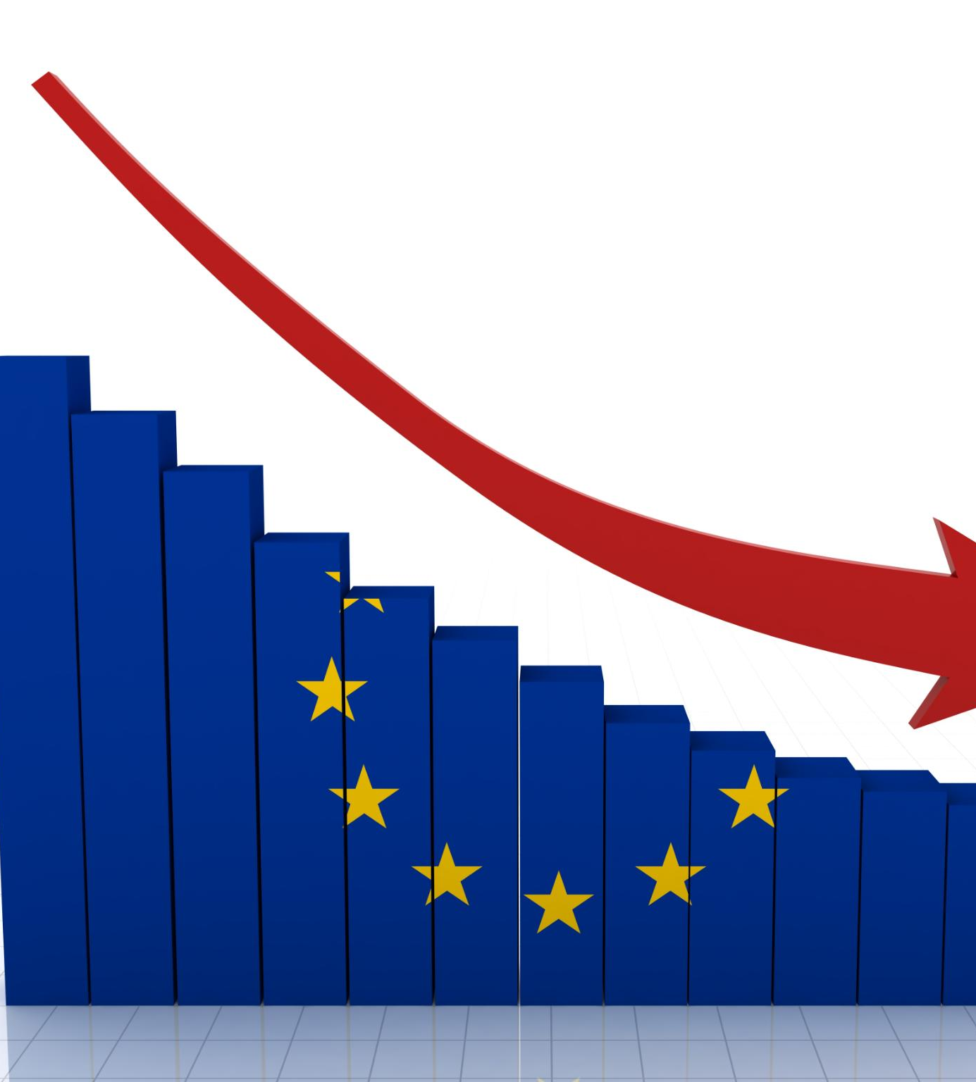
Motivation at the EU level
Rising Interest Rates and Debt Servicing Costs: As interest rates rise, the cost of servicing debt for European governments also increases, straining fiscal budgets.
Impact of Major Crises: The COVID-19 pandemic resulted in significant increases in healthcare spending and social support to address pressing needs. Russia's invasion of Ukraine led to heightened defense spending and instability in the European energy market.
Rising Government Debt: Many EU Member States face rising government debt levels due to the shift in investment priorities and limited fiscal space.
Green and Digital Transitions: Member States are required to focus public investments on green and sustainable projects to meet digital transition demands.
Slowing growth: With limited funds, Member States are exploring strategies to spend more efficiently and maximize investment impacts.

Slide 5

EU Support for Spending Reviews
Country-Specific Recommendations aim to guide Member States on necessary improvements in their spending reviews. MSs are encouraged to implement or enhance their existing reviews based on the CSRs issued by the EU.
Belgium, Spain, Croatia, Italy, and Portugal have successfully conducted at least one spending review since receiving recommendations.
Recovery and Resilience Facility supports essential reforms aimed at enhancing stability and growth in affected regions. Investments made through the RRF focus on building resilience against future challenges and strengthening communities.
Technical Support Instrument provides vital TA to help implement recovery strategies effectively. The EC provides essential guidance for conducting spending reviews, addressing specific requests from national authorities.

Slide 6
Objectives of Spending Reviews
💰 Reduce aggregate expenditure
Identify consolidation measures with no/minimal impact on services.
🎯 Reallocate to strategic priorities
Align spending with evolving government goals & create fiscal space.
⚙️ Improve spending efficiency
Deliver same or better outcomes with fewer resources.
🧠 Analytical capacity building
Enhance budget and policy analysis within the MoF and line ministries.

Slide 7
Types of Spending Reviews
Comprehensive Spending Reviews | Targeted Spending Reviews
Broad coverage across sectors | Focus on specific sectors or issues
Used for major fiscal consolidation or strategic resets | Used regularly or ad hoc for performance improvement
High resource and capacity requirements | Lower administrative burden
Less frequent | Annual or multi-annual in some countries
e.g. UK (2010), Canada (2011), Ireland (VfM reviews) | e.g. Denmark, Netherlands, Finland

Slide 8
Dimensions of Spending Reviews
By Focus Area:
🔹 Program Reviews – Analyse services or transfer payments for effectiveness/efficiency.
🔹 Process Reviews – Examine business processes (e.g., procurement, IT) for efficiency.
🔹 Agency Reviews – Evaluate the entire operations of a ministry or agency.
By Review Type:
🔸 Vertical Reviews – Within one organization or agency and its subunits (e.g. environment).
🔸 Horizontal Reviews – Across multiple agencies, focusing on a shared function (e.g. public sector wage bill).

Slide 9
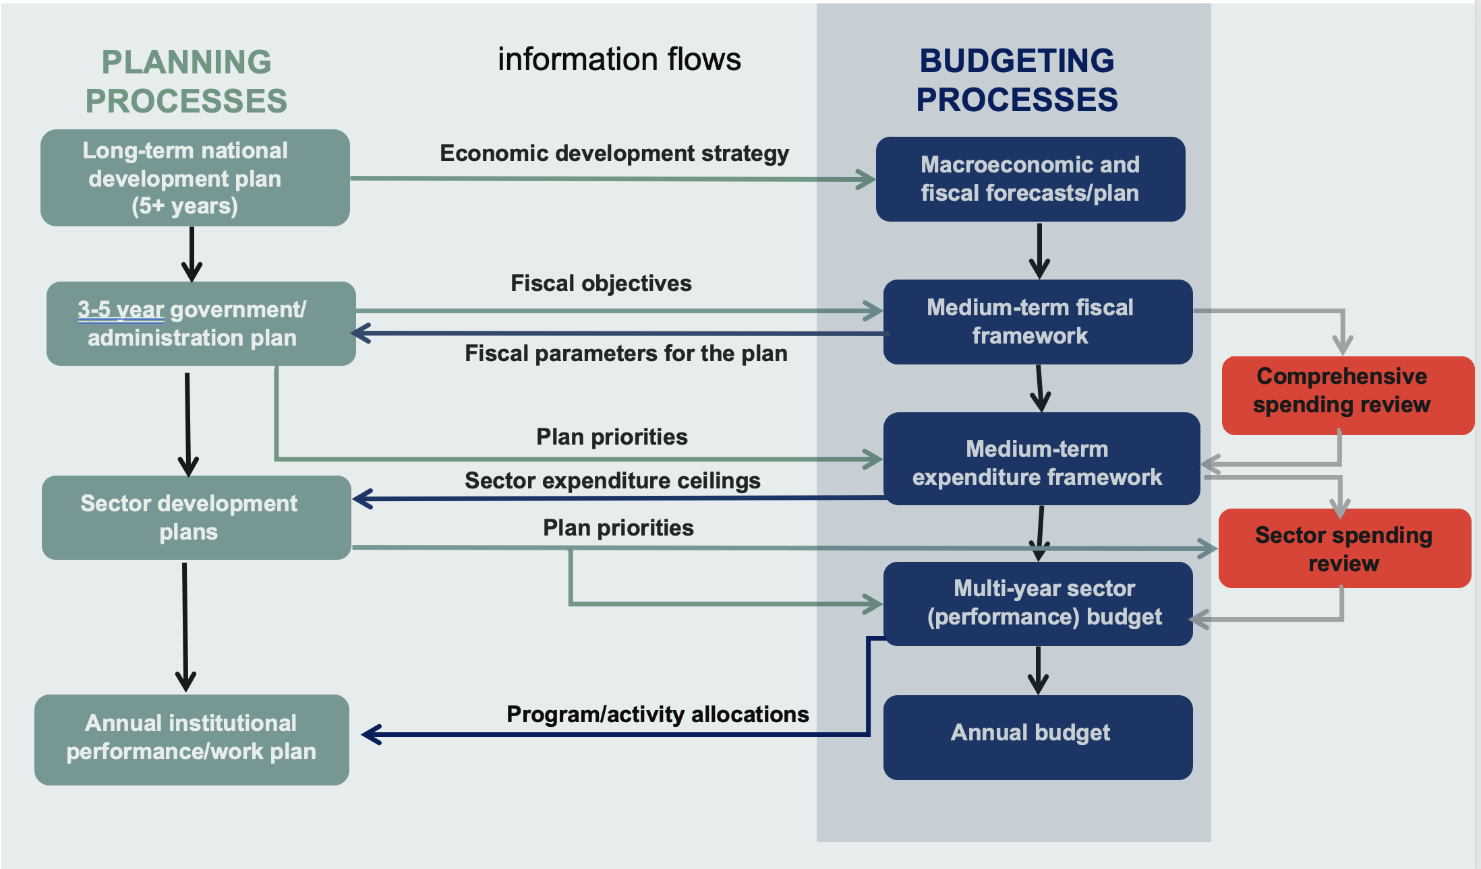
Alignment of spending reviews with strategic planning and budgeting processes
Notes:
Spending reviews should be aligned with the budget calendar.
Integration allows SRs to:
➜ Set savings targets based on fiscal forecasts
➜ Support medium-term budget planning
➜ Inform decisions on new vs. ongoing spending
Results feed into budget formulation and multi-year allocations.
A structured SR timetable improves decision-making.

Slide 10
Institutional Set-Up & Operational Models
Requires high-level political endorsement and cross-institutional coordination.
Risk of resistance from ministries makes strong governance essential.
Three models for organizing SRs:
Bottom-up: line ministries propose savings (Canada, UK).
Top-down: MoF or Cabinet imposes targets (France).
Hybrid: joint teams from MoF and line ministries develop proposals collaboratively.
Hybrid model promotes ownership, technical quality, and feasibility.

Slide 11
Proposed Governance Structure of Spending Reviews for North Macedonia
Political decision-making
Technical analysis
Government
SR Secretariat
Coordination & quality control
Proposes prioritization
among Pilots/SRs
Ministerial Steering Committee (MSC)
Prepares TOR for SRs
Challenges proposals
SR Secretariat /
SR Unit
SR Working Group 1
SR Working Group 2…
Working Group
Conducts the analysis
Internal contributions:
Data providers (CSO, internal audit)
Public service under review (LGs)
External contributions:
- Independent Bodies (Fiscal Council, SAO, think thanks, academia)
- Trade unions
- IFIs, external consultants
Collects contributions
Proposes reform options
Prepares SR report
Notes:
Let’s now take a look at how all the elements of the spending review process come together in an institutional structure, based on the hybrid approach recommended for The Country.
This diagram outlines the proposed institutional set-up, drawing from international best practices, and tailored to the specific administrative context of Kosovo. I’ll briefly walk you through each layer, from top to bottom.
At the top, we have the Government (GoM). This body plays a vital decision-making role, both at the start and the end of each spending review. The GoM formally approves the Terms of Reference for each review — setting the objectives, savings targets, and scope — and later makes the final decisions on the reform proposals developed through the reviews. Their endorsement gives the process political legitimacy and ensures that line ministries take implementation seriously. Without this level of engagement, proposed reforms often stall or get reversed.
Below the GoM is the Ministerial Steering Committee (MSC), housed within the Ministry of Finance. This committee is chaired by the Minister of Finance and includes senior officials from both the MoF and the line ministries whose spending is under review that year.
The MSC acts as the strategic anchor throughout the process. It meets regularly — at least monthly — with the SR teams, monitors their progress, and ensures that the reviews remain aligned with overall budget targets. The MSC is also responsible for submitting proposals to the GoM and preparing official communications around the decisions taken. The committee’s composition may change each year, depending on which ministries are involved in that year’s reviews.
The Spending Review Unit (SRU) is the technical and operational hub of the process. This unit, located in the Budget and Funds Department of the MoF, handles the day-to-day coordination and quality control. It proposes review topics, drafts ToRs, develops guidance, supports the SR teams, and consolidates final reports. The SRU also acts as a center of expertise, helping to build long-term analytical capacity across the MoF and line ministries.
At the working level, each review is carried out by a dedicated Spending Review Team / SR Working Group. These teams are jointly staffed by MoF budget analysts and representatives from the line ministries and, where appropriate, local governments. Typically, these are small teams — about 5 to 7 people — led by a MoF official. Their job is to conduct detailed analysis, evaluate savings options, and assess the policy and service delivery implications of various reform measures.
One important feature here is the involvement of civil servants and independent experts, while keeping the process apolitical. Line ministries are expected to actively contribute by providing data, reviewing the feasibility of proposed changes, and supporting implementation. Where needed, SR teams can also consult with internal auditors, the State Audit Office, academia, or sector experts, although auditors themselves won’t directly participate due to potential conflicts of interest.
Finally, the structure encourages ongoing coordination between the MSC and the SR teams — ensuring guidance flows downward, and insights from the reviews can inform strategic decisions. It's also worth noting that team members are encouraged to contribute ideas freely — there’s no veto power within the teams — ensuring that the final report to the GoM includes a range of policy options.
This structure strikes a balance between technical quality, political support, and institutional ownership. It allows The Country to gradually build capacity, deepen analytical practice, and ultimately strengthen the impact of public spending.
After pilot SRs, a clear legal mandate is needed to ensure the process is conducted on a regular basis. Lessons learned from the initial SRs will inform the drafting of this mandate, which could incorporate key principles such as transparency, integration into the budget process, governance, organisational structure, and the general SR approach. Institutionalisation of the SR process will require a medium-term SR program to ensure that all relevant spending areas are reviewed over time. This program could be incorporated into the FS or fiscal policy statement, ensuring comprehensive coverage of all line ministries and the selection of relevant topics, over the government’s mandate.

Slide 12
Key stakeholders and roles
Political decision-making
Government (Cabinet)
Adopts Decision to launch SR (framework, SR areas, ToR with objectives/targets/timeline)
Appoints MSC and gives it and the MOF a mandate for SR
Decides on saving target(s) & timeline for implementation
Adopts SR reports
Makes final decisions on cuts and reallocation options
Provides political leadership and communicates publicly
Ministerial Steering Committee (MSC)
[Minister/Deputy Minister of Finance (Chair), relevant line minister(s), senior staff from MOF (macro-economic policy, Budget, Treasury) & respective line ministries]
Provides strategic direction, guidance & mandate to SR Working Groups
Holds progress meetings on conducted SRs
Reviews & challenges proposals by SR Working Groups, ensuring saving options alignment with targets
Ensures line ministries’ active participation in SR process
Communicates internally
Approves SR reports & submits them to Govt for considerations & approval
Submits recommendations/policy options to Govt for considerations & approval

Slide 13
…continued
Technical Analysis
SR Secretariat / SR Unit:
Conducts high-level international benchmarking/sectoral analysis/analysis of performance indicators to identify & recommend to Govt sectors for SR
With respective budget analysts, develops SRs saving targets in line w/ medium-term fiscal objectives; drafts SR ToRs
Drafts decisions for Govt approval (targets, spending review areas, timeline)
Collects & ensures data access for SRs
Defines procedures for SR / guidance to SR Working Groups on methodology / provides report templates
Oversees SR process & participates in finalization of SR reports.
SR Working Groups:
Conduct spending reviews.
Prepare reform options within the defined target savings.
Prepare quality, social and risk assessment, as well as legal review.
Prepare other qualitative recommendations.
Prepare the SR report and other interim reports, in line with ToR timeframe.

Slide 14
Thank you

