Slide 1

Value for Money and Spending reviews
Adam Marek
Director, Health and Social Expenditures
Value for Money Division

Slide 2
Why do we analyse public spending?
Greater efficiency of public spending by:
Cutting wasteful spending
Getting more value for the same spending
Identifying the most promising areas for additional spending
Making public spending more transparent

Slide 3
Why do we analyse public spending?
Greater efficiency of public spending by:
Cutting wasteful spending
E.g. extra funding for small schools in remote areas going to private schools in the capital
Getting more value for the same spending
E.g. nurses rather than physicians
Identifying the most promising areas for additional spending
E.g. prioritisation of transport investments, mental health
Making public spending more transparent
Health spending vs health results?
How much money do hospital physicians actually make?
What is the health benefit of the latest pharmaceuticals?

Slide 4
What we do
Spending reviews
Investment appraisals
Analytical support for the budgeting process
Internal consulting

Slide 5
What is a spending review (OECD description)
Spending reviews support the sustainability of public finances through systematic analyses of existing expenditures
They help governments to manage
Overall level of expenditure
Identify savings or reallocation measures to fund new priorities
Improve effectiveness within programmes and policies
Key elements that contribute to successful outcomes include
Clear objectives and scope
Strong political leadership and commitment
A direct link with the budget process

Slide 6
What is a spending review (OECD description)
Spending reviews support the sustainability of public finances through systematic analyses of existing expenditures
They help governments to manage
Overall level of expenditure
Identify savings or reallocation measures to fund new priorities
Improve effectiveness within programmes and policies
Key elements that contribute to successful outcomes include
Clear objectives and scope
Strong political leadership and commitment
A direct link with the budget process

Slide 7
What we don’t do
At the Ministry of Finance, we have
Institute for Financial Policy (macro and tax forecasts, fiscal policy, long term trends)
Budget Policy Section
Outside of the Ministry of Finance, there are
Line ministry analytical units
Council for Budget Responsibility
Supreme Audit Office
Think tanks

Slide 8
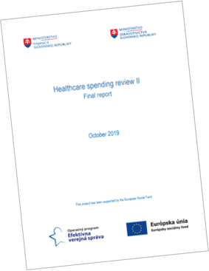

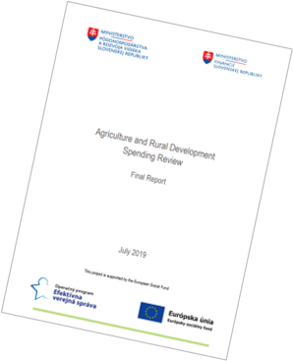
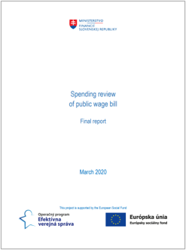


Value for Money division was created in 2016
VfM division started with 3 full-time employees, currently there are 40. We have prepared 23 spending reviews.
Creation of VfM was a result of bottom-up initiative of public servants.
The main motivation was a change in attitude – to not only „comply with the law“ but to look for the best option.

Slide 9
We have prepared 23 reviews
Spending reviews by topic or sector and revised expenditure envelopes (billion EUR, current prices)
Energy (2,4)

Slide 10
VfM assesses around 30 investment projects annualy
Number of assessed investment projects and assessment updates
Change of the threshold to 1 mil. EUR

Slide 11







Investment management reform
Creation of prioritisation methodology and investment plan by ministries
Ex ante assessment of projects >EUR 10/40 million based on a resolution of the Government
Cancellation of Economic assessment of projects > EUR 1 million
Ex ante assessment of projects >EUR 10/40 million based on a law
Economic assessment of projects > EUR 1 million based on a resolution of the Government
Ad hoc economic assessment of projects
Link state budget and investment plans
Before 2016
2016
2019
2020
2021
2024
2025 ...

Slide 12


What makes a spending review successful?
Political ownership
Capacity development
Transparency and communication
Implementation and budgetary process

Slide 13
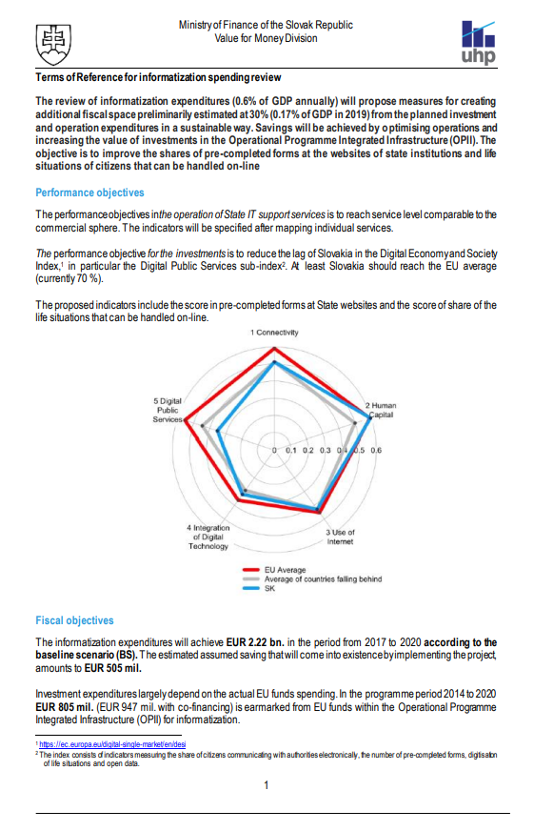
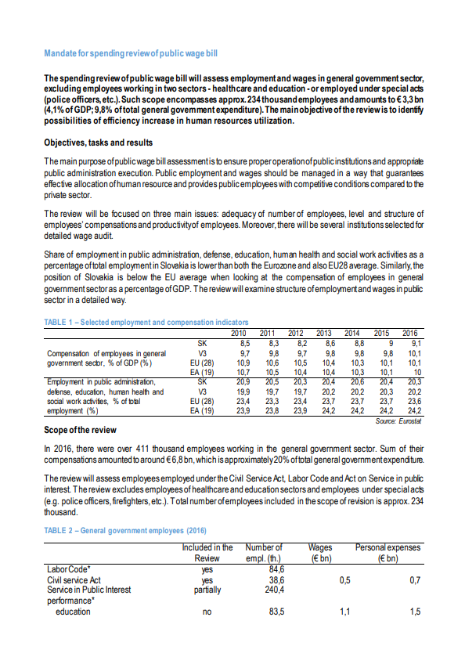
Ownership defines half of the success
High-level political ownership
Sustained support from both the PM and MoF is essential to the success of the spending review and its implementation
Mandate for the review from the government (ToR)
Involvement in line ministries
Purely MoF-driven spending review is likely to be met with passive resistance from the concerned line ministry

Slide 14
Internal capacities are good value for money
Internal capacities of analytical units built by:
Long term development
Specialised courses
Cooperation with the IMF and OECD
Number of FTEs in analytical units

Slide 15
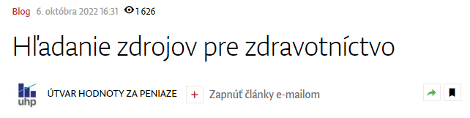
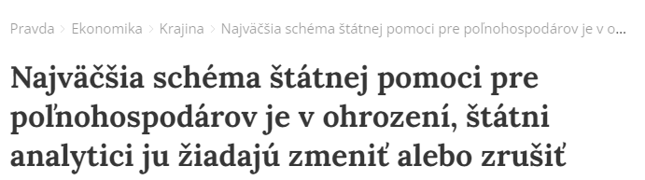
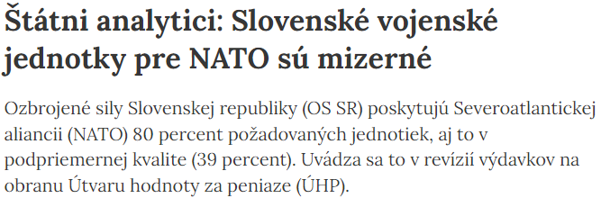
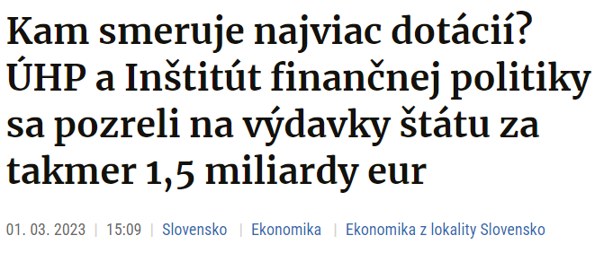
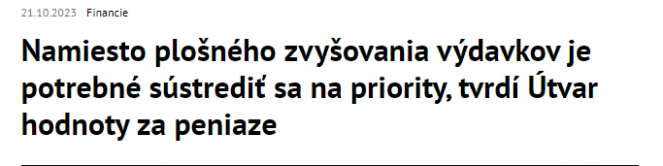
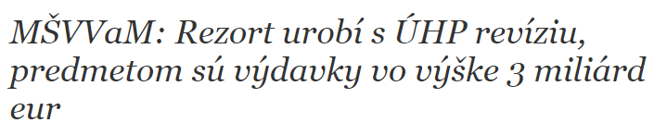
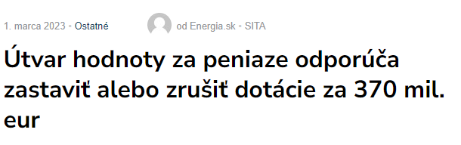
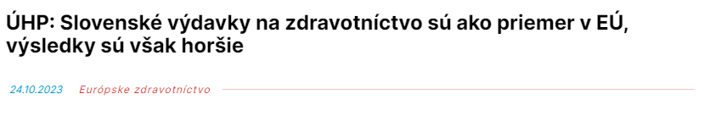
Publish everything and talk about it
All spending reviews and most of the analyses are public – it helps to create public pressure
In 2023: almost 3 000 mentions of VfM in the media, 57 published outputs

Slide 16

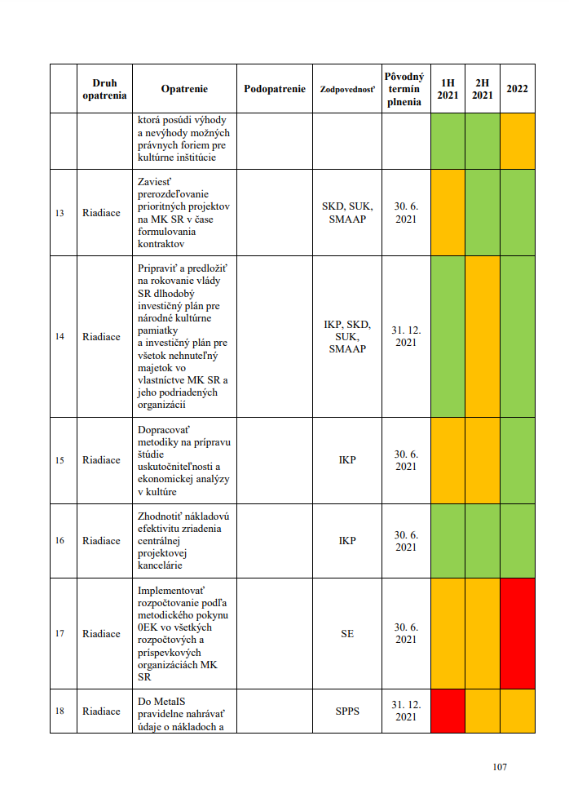
Rigorous implementation is key to delivery
Implementation can be the hardest part of the process
Central implementation unit within deputy prime minister´s office
Monitors progress and helps with the implementation of measures
Issues a status report once a year
Status report methodology
Status | Colour
Fulfilled (more than 100 %)
Fulfilled
Partially fulfilled
Not fulfilled
Excessive spending or data not provided
Measure is scheduled to be implemented later

